Slide 1
Using GMOs to teach gene expression and gene technology
Authors
Geniusly-Modified Ohioans
Jackie Augustine
Jennifer Larson
Matt Misicka
Aaron Wenzel
Details
BIO 1101
BIO 1113
Any number of students
Start in lecture, debate in lab

Slide 2
Pre-Class Activity
Read: Weed Killer, Long Cleared, Is Doubted
http://nyti.ms/1HZVGVH

Slide 3
REVIEW:
Transcription cannot begin until…
1
The two DNA strands have completely separated and exposed the promoter
RNA polymerase binds to the promoter
The 5’ caps are removed from the mRNA
The DNA introns are removed from the template
DNA nucleases have isolated the transcription unit
Notes:
Clicker question

Slide 4
REVIEW:
What is transcribed…
1
Promoter, start codon, gene, stop codon
Promoter, start codon, gene
Start codon, gene, stop codon
Start codon, gene
Only the gene
Notes:
Clicker question
After this, remind students that we learned last time, that promoters, start codons, and stop codons must all be functional to make a functioning mRNA transcript.

Slide 5
Learning Objective for this Tidbit:
Students will be able to:
  Predict new traits of organisms that are transfected with plasmids
  Explain how plasmids are constructed
  Describe what a GMO is
  Evaluate the effects of introducing new genes to organisms
Learning Objectives for other Tidbits:
Students will be able to:
  Debate the pros and cons of GMOs
  Identify regulatory elements important for gene expression
  Communicate the relationship between genotype and phenotype
  Propose experiments to test whether a plant is a GMO or not
General Skills:
  Students will take part in scientific discussions/debates
  Students will practice utilizing the scientific method

Slide 6
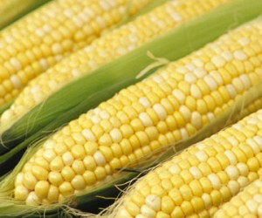
The Roundup Story
Is this corn genetically modified, conventional or organic?
What does it mean to be genetically modified?
Are you for/against/undecided regarding the use of GMOs?

Slide 7
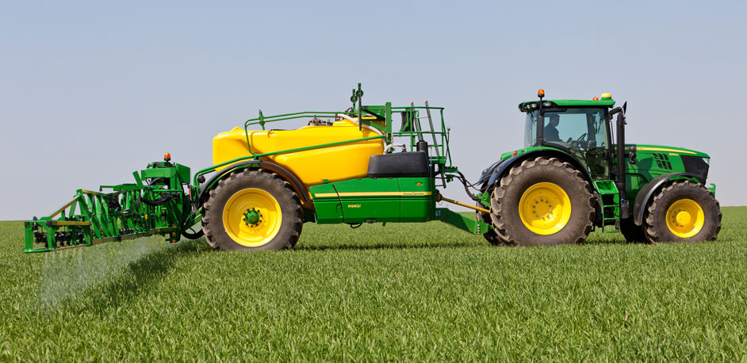
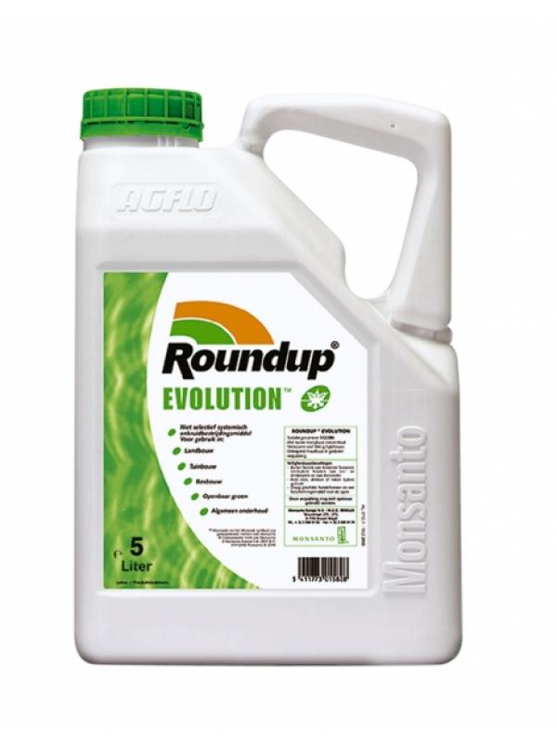
What is Roundup?

Slide 8
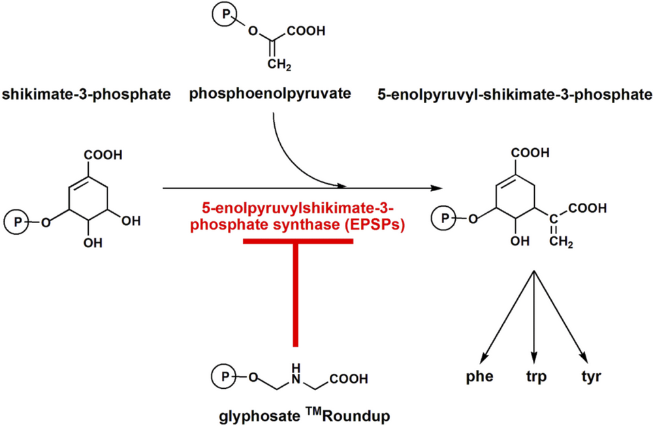
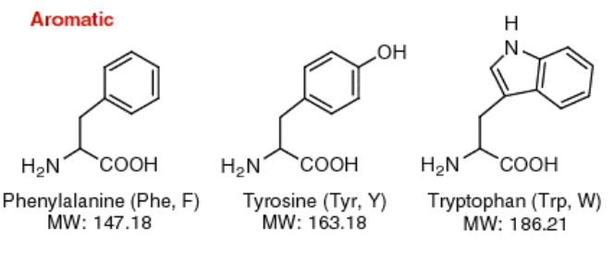
The Roundup Story

Slide 9
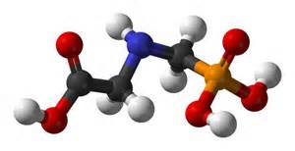
The Roundup Story

Slide 10
The Roundup Story
Roundup is a very effective herbicide, but it kills crops
Scientists furiously searched for a gene that confers resistance to Roundup, so it could be inserted into crop plants
  Why would they want this?
Agrobacterium was found to have high tolerances to Roundup
What they inserted:
Petunia
EPSP
CTP
E35S Promoter
Agrobacterium EPSP
NOS Terminator
Plant DNA
Plant DNA

Slide 11
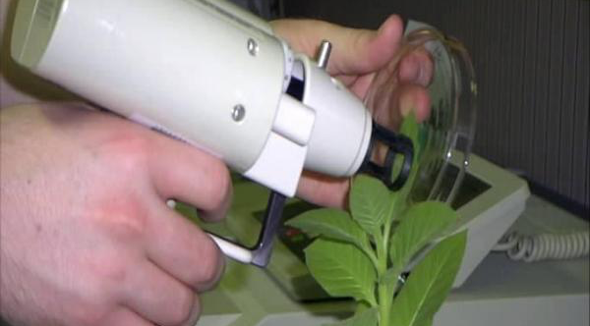
The Roundup Story: Getting the DNA into plants
http://www.nepadbiosafety.net/subjects/biotechnology/plant-transformation-bombardment

Slide 12
Application questions
Why were promoter and terminator sequences added?
The 35S promoter is associated with a gene important for ribosome formation. Why would they choose this promoter?
Next comes the sequence for a chloroplast transit peptide. This sequence directs the EPSP protein to go into chloroplasts. Why didn’t Agrobacterium EPSP have this sequence already in the gene?
Why might it be important to insert the gene in the correct organelle/tissue?
Petunia
EPSP
CTP
E35S Promoter
Agrobacterium EPSP
NOS Terminator
Plant DNA
Plant DNA
Notes:
Another in-class discussion (think, pair, share technique)?

Slide 13
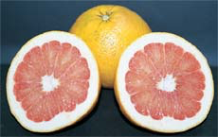
Pink Lemonade
You are a team of scientists working in a biotech company and it is your job to create a new type of lemon that tastes like pink lemonade when squeezed.
Get in groups of 3-4 and use the handout to plan out your proposed genetic construct.

Slide 14
How will you make your construct?
What genes will you need to include?
  Does it matter what order you put them in?
Where in the plant would you want these genes to be expressed?
  How would you do this?
    Add a protein targeting sequence?
    Is there another way?
      Use a promoter that is on specifically in fruits.

Slide 15
How will you make your construct?
      ACC Oxidase – makes ethylene. This is a fruit-specific gene but if we overexpress it then the fruit will become too soft.
What promoter did you use?
Would you drink this pink lemonade?

Slide 16
Class 2 Homework
Debate for/against GMOs
Support arguments with scientific literature
Your side in the debate (for/against) will be determined the day of the debate
Each group gets to make a brief opening statement defending their assigned position (about 4-5 minutes)
Groups opposing get to challenge your view with one or two questions
Initial group answers the questions (1-2 minutes)
Time permitting we will go to a more general discussion involving all groups
Debate will occur in lab next week.

Slide 17
Class 3: Horizontal Gene Transfer
Mechanisms of horizontal gene transfer: How can we tell them apart?
Activity: Ask students
  1) how they can tell if corn is genetically modified or not?
  2) how they would be able to determine if a GMO had spread to wild plants.

