Slide 1
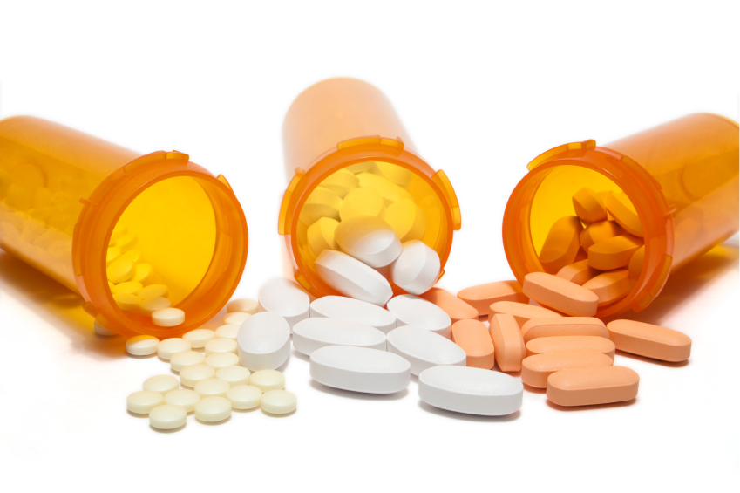
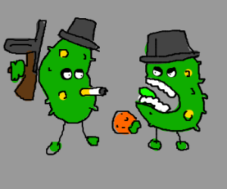
Drug Problems

Slide 2
The Set-up
Introductory biology
Majors-level
400-student lecture (so 250 show up)
Fixed seating lecture hall (IH 100)
TAs to help facilitate small group discussions

Slide 3
Learning Goals
Understand evolution by natural selection
Explain bacterial genetics (gene transfer, gene expression, mutation)
Understand modern applications of biology to society
Develop scientific literacy

Slide 4
Learning Outcomes
Students should be able to:
Identify molecular targets of antibiotics
Explain what roles mutations and natural selection play in antibiotic resistance
Explain how resistance in one bacterial species can be acquired by another
Predict how changes in antibiotic use will affect the frequency of resistance
Formulate hypotheses and interpret scientific graphs

Slide 5
Setting the Scene:
The Third Man
https://www.youtube.com/embed/F-QWLAndD1E
Notes:
Maybe cut the movie, save 1-2 minutes

Slide 6
Public Health History
Prior to 1945
90% of children with meningitis died
Strep throat was frequently fatal
Tuberculosis, pneumonia, and whooping cough were serious public health concerns
After 1945
Human life expectancy increased by 8-10 years
Are the above diseases still life-threatening?
Notes:
Maybe hide slide to save time; skip straight to increases in antibiotic resistance because that’s scary and interesting

Slide 7

Public Health History
Hooray, antibiotics!

Slide 8
HelthWyzer, your pharmaceutical company, has recently launched a new area of research with the goal of developing better antibiotics.
Biologically, what two general criteria must you consider for your drug candidates to be effective?
What are useful antibiotics targets within a bacterial cell?
Notes:
Said maybe to skip this; but I think we should try to keep it; if tight for time, could just show them the graphic with different types of mechanisms of action
Important for students to know how antibiotics target bacteria in order to think about how mutations could enable resistance

Slide 9
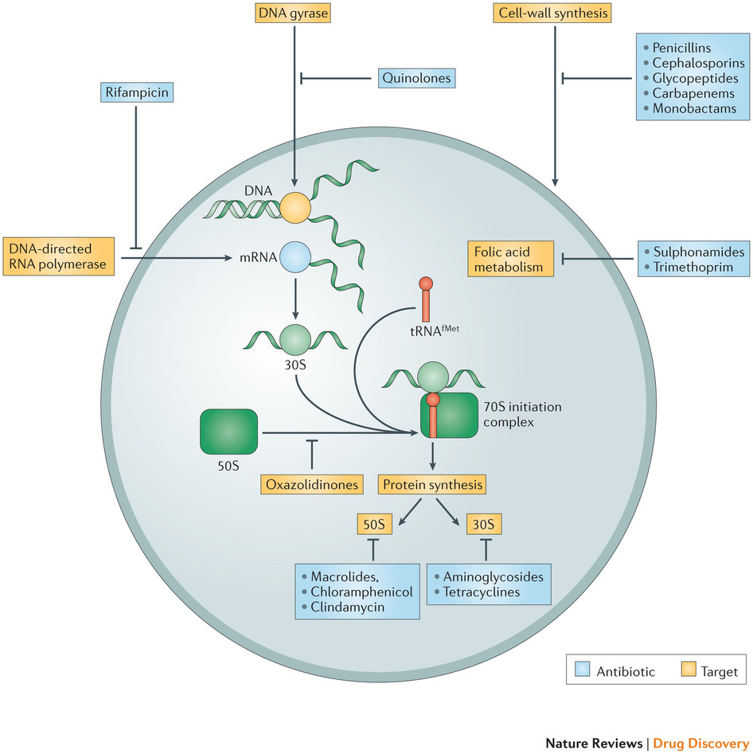
Targets of Antibiotics

Slide 10
You develop drug X, which blocks protein synthesis by binding an essential part in the bacterial ribosome.
Two years after introduction onto the market, it became ineffective.
Change wording to say that the drop stops working?
That way the answer can be “resistance” and we can segue into resistance
What it is
How it happens
Etc.
What happened?

Slide 11
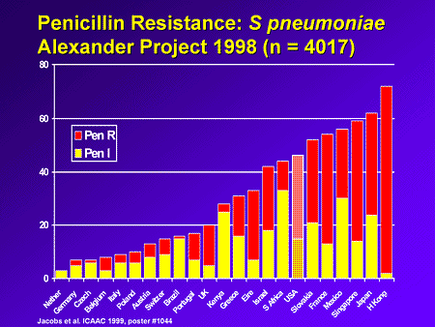
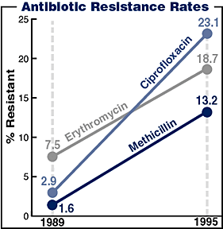
Trouble in Paradise
Notes:
Talk about this and comment on increasing resistance frequency – ooh, scary!
S. pneumoniae - http://img.medscape.com/slide/migrated/editorial/cmecircle/2001/204/jacobs/slide04.gif
Antibiotic resistance - http://www.dynamicchiropractic.com/content/images/antibiotic_resistance.gif

Slide 12
How do bacteria develop antibiotic resistance?
They evolve in order to overcome the antibiotic and survive
Antibiotics cause genetic mutations over time that protect the future generations of bacteria
Some bacteria are naturally resistant to antibiotics, and they’re the ones that reproduce
This is a common misconception– people just use the wrong antibiotic, or the dose is too weak
Notes:
Ask students to answer on own. Don’t comment on which answer is correct – do activity first and let them see if they change their mind.

Slide 13
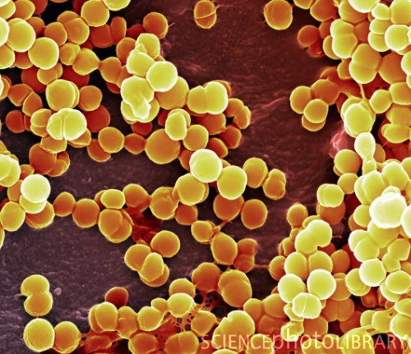
Antibiotic Resistance
What are some examples of antibiotic resistant bacteria?
  MRSA (methicillin-resistant Staphylococcus aureus)
  VRSA (vancomycin-resistant Staphylococcus aureus)
  ?
Notes:
http://40.media.tumblr.com/tumblr_m5d68syx5y1qg1up7o1_500.jpg
“?” is for students to mention any others they might know of, or have heard of in the news recently

Slide 14
Antibiotic Resistance
What does it mean to “resist” an antibiotic?
Is it something the bacteria chose to do?
Notes:
Scientific literacy
“Resist” has an active, intentional sound to it – what does it mean biologically?
Ask how it’s possible, but they might not know
That’s OK, have an animated bullet list ready
Ask for answers to last Q and rather than commenting on right or wrong, ask for them to back up their answer, and ask for a diversity of other perspectives

Slide 15
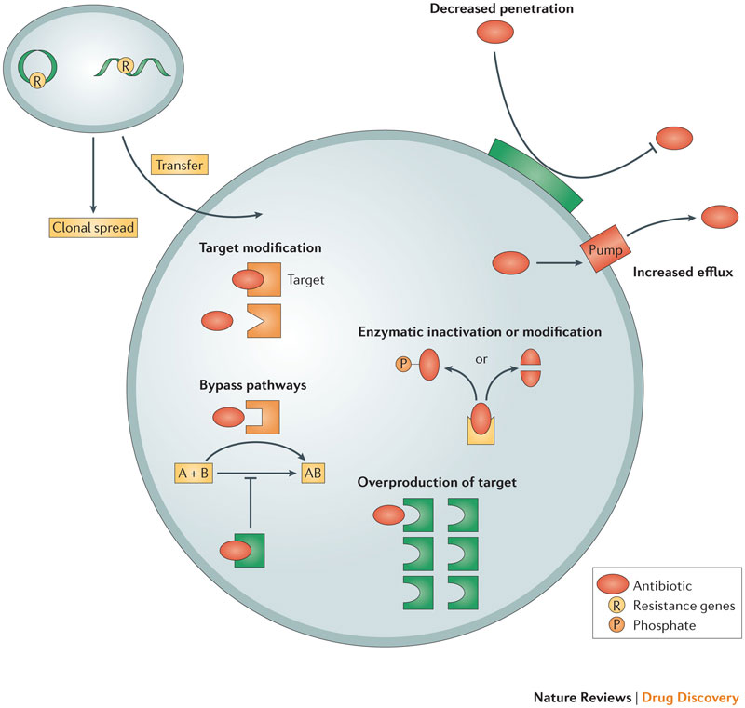
Resistance Mechanisms

Slide 16
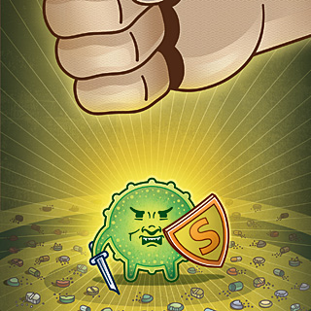
Superbug Origins
How do “superbugs” become “super”?
i.e. Where do traits that confer resistance come from?
  Mutation
Notes:
http://www.scientificamerican.com/sciam/cache/file/A7039614-25ED-4FEA-8740DB7E21A3B081.jpg
Guiding Qs – we talked about traits bacteria might possess on the previous slide, and those traits confer resistance
Where do those traits come from?
What are traits? What determines them?
Phenotypes
DNA/genotypes
Where do ALL new traits ultimately come from?
Novel DNA sequences
Mutations
How else can bacteria acquire novel DNA sequences?
- Gene transfer (transformation, transduction, conjugation)

Slide 17
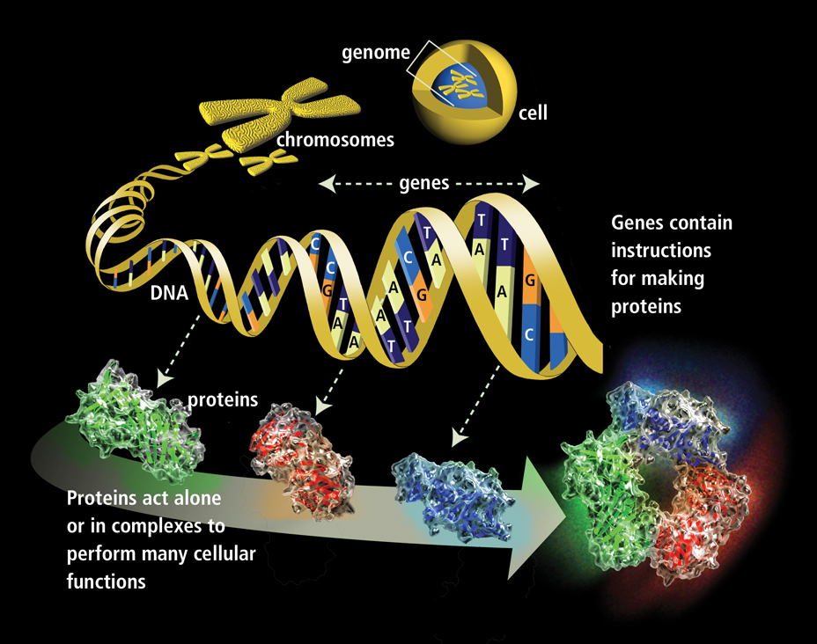
What’s wrong with this picture?
(Hint: we’re talking about bacteria)

Slide 18
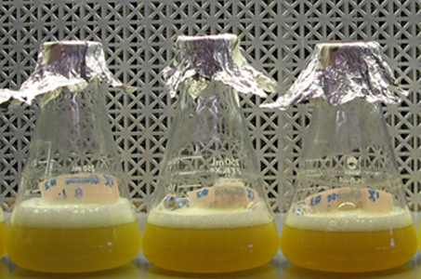
Sample Experiment
A B C
3 flasks of E. coli (all the same strain):
A – no antibiotic added
B – treated with vancomycin
C – treated with chloramphenicol
Conclusions about this strain:
Contains resistance to chloramphenicol
Did not contain resistance to vancomycin

Slide 19
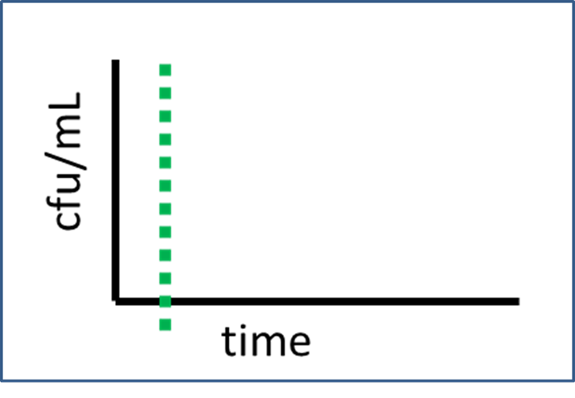
Sample Experiment
What results would support the scientist’s conclusions?
Work with a small group (4-5) to create graphs showing the changes in population density in Flask A, B, and C
Flask A: control, Flask B: vancomycin, Flask C: chloramphenicol

Slide 20
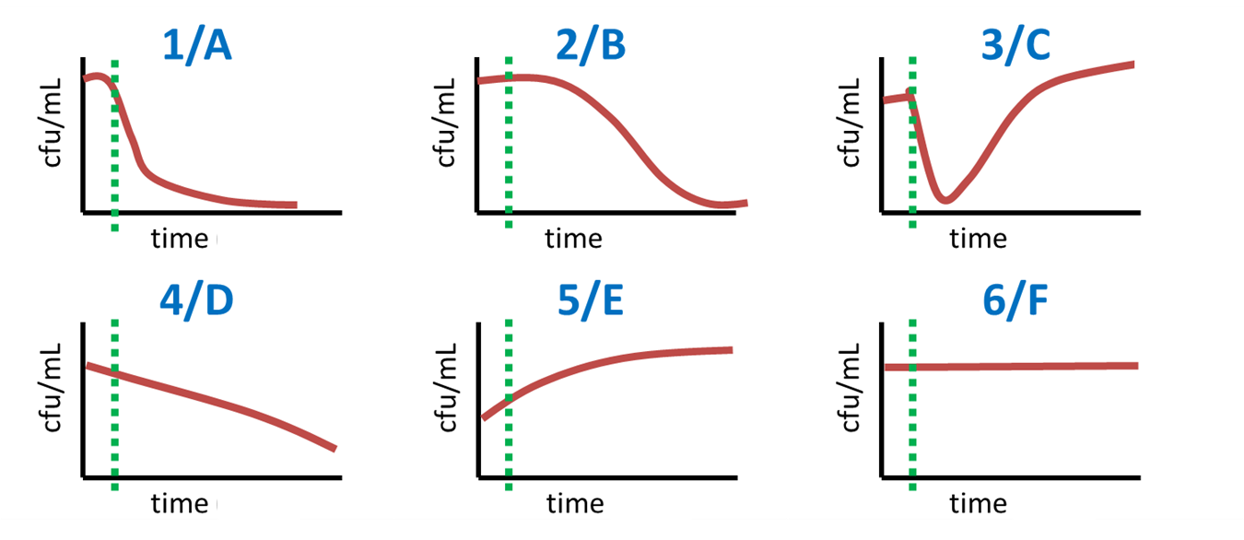
What did the scientist see?
(pick the closest approximation)
Flask A: control, Flask B: vancomycin, Flask C: chloramphenicol
Notes:
If they pick graph 5 for Flask C, ask them to also evaluate graph 3

Slide 21
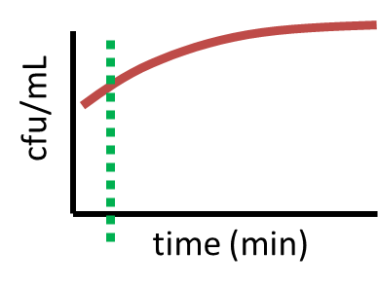
Flask A (no antibiotic):
What’s happening here?

Slide 22
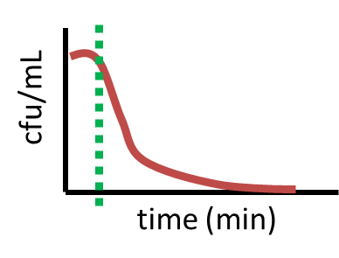
Flask B (vancomycin):
What’s happening here?

Slide 23
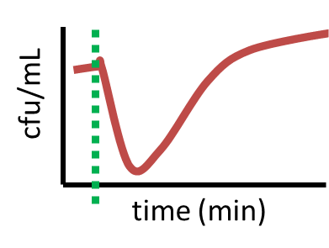
Flask C (chloramphenicol):
What’s happening here?

Slide 24
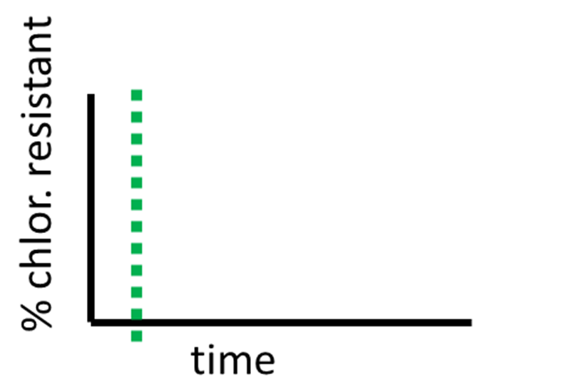
Sample Experiment
Work with a small group (4-5) to create graphs that show the changes in chloramphenicol resistance in Flask A, B, and C

Slide 25
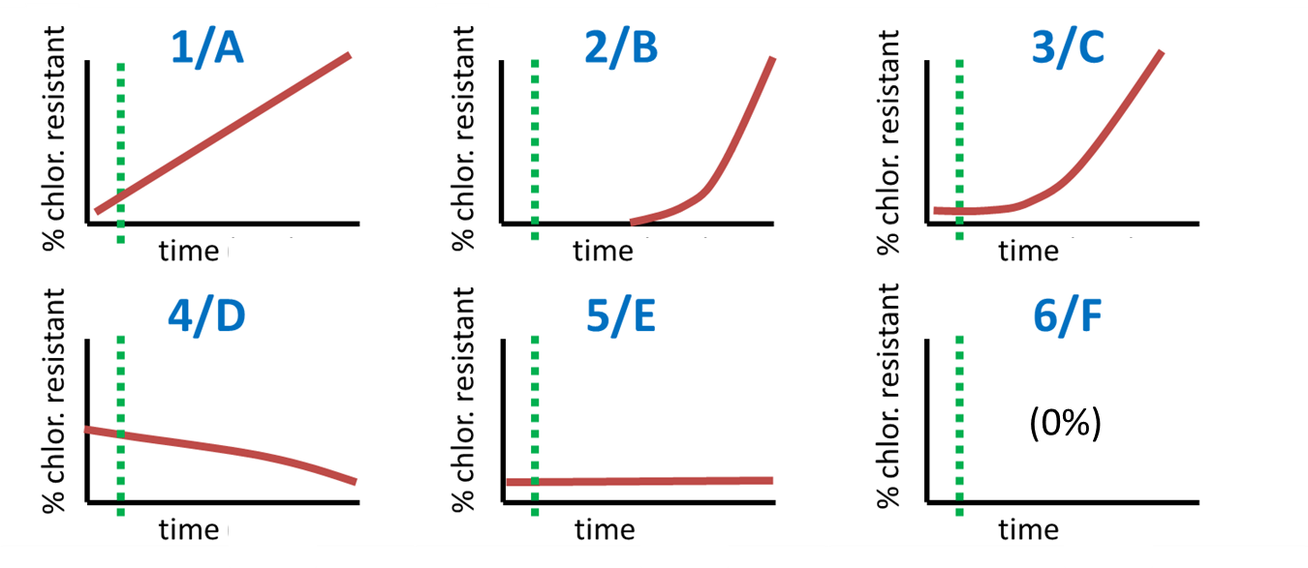
What did the scientist see?

Slide 26
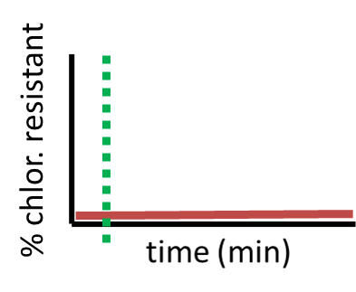
Flask A (no antibiotic):
What’s happening here?

Slide 27
Flask B (vancomycin):
What’s happening here?

Slide 28
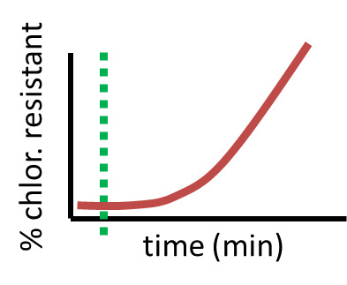
Flask C (chloramphenicol):
What’s happening here?
Notes:
What process is happening here? What can explain how the frequency of resistance increases?

Slide 29
Sample Experiment
When did the E. coli develop resistance to chloramphenicol?
  Before or after the chloramphenicol was added to the flask?
How would you explain that the E. coli did not develop resistance to vancomycin after it was added to the flask?

Slide 30
Sample Experiment
Does the introduction of a selective pressure cause the adaptive mutation to occur?
Does the misuse of antibiotics cause the mutation that leads to resistance?
What is a better way to explain the link between antibiotic misuse and resistance?

Slide 31
How do bacteria develop antibiotic resistance?
They evolve in order to overcome the antibiotic and survive
Antibiotics cause genetic mutations that protect the future generations of bacteria
Some bacteria are naturally resistant to antibiotics, and they’re the ones that reproduce
This is a common misconception– people just use the wrong antibiotic, or the dose is too weak

Slide 32
Activity 2
We need 3 brave volunteers…
Follow the story
Keep track of the important events
Solve the mystery!
Notes:
Maybe make a slide with a series of pictures of the three people interacting to save the time from students needing to get up, learn how to act out the skit, etc.

Slide 33

X
Y
Antibiotic
Antibiotic

Slide 34
X
Y
Achoo
Antibiotic
Antibiotic

Slide 35

X
Y
Z
Achoo
Achoo

Slide 36
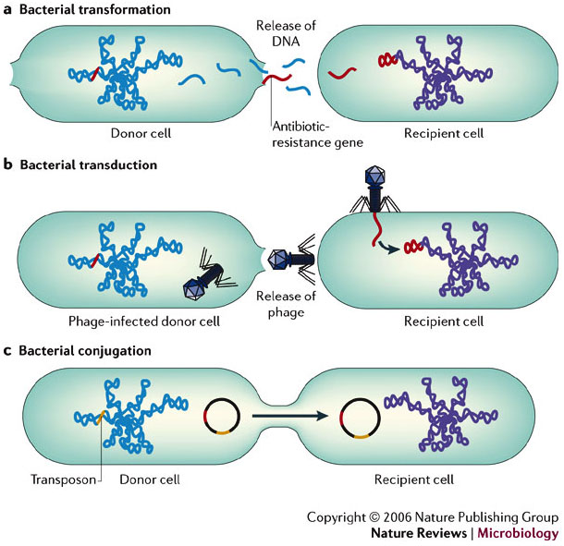
Bacterial Gene Transfer

Slide 37
Public Health Policies
What human behaviors contribute to increased antibiotic resistance?
What changes would you propose to mitigate antibiotic resistance?
Notes:
If tight for time, “Think about this at home and bring it back tomorrow!”

