Slide 1
Of Mice and Methyl Groups
(Presenter name) – (Presentation date)

Slide 2
Learning Goals
Science skills
Students will understand several mechanisms of epigenetic inheritance.
Students will understand the difference between genetic and non-genetic inheritance.
Identify examples of non-Mendelian patterns of inheritance.
Students will develop skills for analyzing scientific literature
General skills
Students will participate in class discussions
Science attitudes
Students will recognize social and philosophical implications of scientific discovery.
Students will understand and appreciate the potential of science to address contemporary societal problems

Slide 3
Intended outcomes
At the end of the class, students should be able to:
  Read scientific literature and differentiate epigenetic from non-epigenetic inheritance
  Give examples of epigenetic inheritance
  Describe natural events that modify epigenetic markers
  Evaluate risk factors that affect heritable epigenetic changes

Slide 4
Expected Prior Knowledge
Students will have been introduced to and be proficient in Mendelian genetic inheritance.
Students will understand the structure of DNA, and will be aware that DNA has a negatively charged phosphate backbone.
Students will have been introduced to RNA Polymerase and Transcription factors, and know their role in DNA transcription and translation.
Students will know how DNA is bound in chromatin, and know about nucleosomes, histones, and understand their role in DNA packaging.
Students will have a general working knowledge of electrostatic forces.

Slide 5
Pre-class activity
Lick Your Rats!
http://learn.genetics.utah.edu/content/epigenetics/rats/

Slide 6
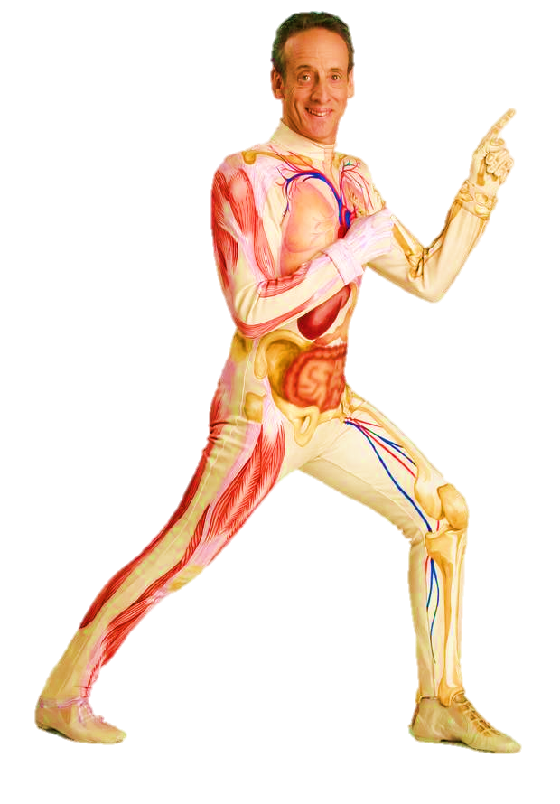
MYSTERY ABOUNDS:
Each cell in your body is a genetic clone. How is it possible to have so many tissue types and organs that all do completely different things if their genetics are identical?

Slide 7
What is Epigenetics?
Epi = on, upon, or above
Genetics = genetics
Literally means “above, or, upon the genome!”

Slide 8
What is Epigenetics?
Epigenetics refers to the mechanisms that silence/activate specific genes.
But how is this done?

Slide 9
Epigenetic Mechanisms
There are two broad epigenetic mechanisms that act directly upon the genome:
  DNA Methylation
  Histone Acetylation
Both mechanisms influence RNA Polymerase access to genes.

Slide 10
Histone Acetylation

Slide 11
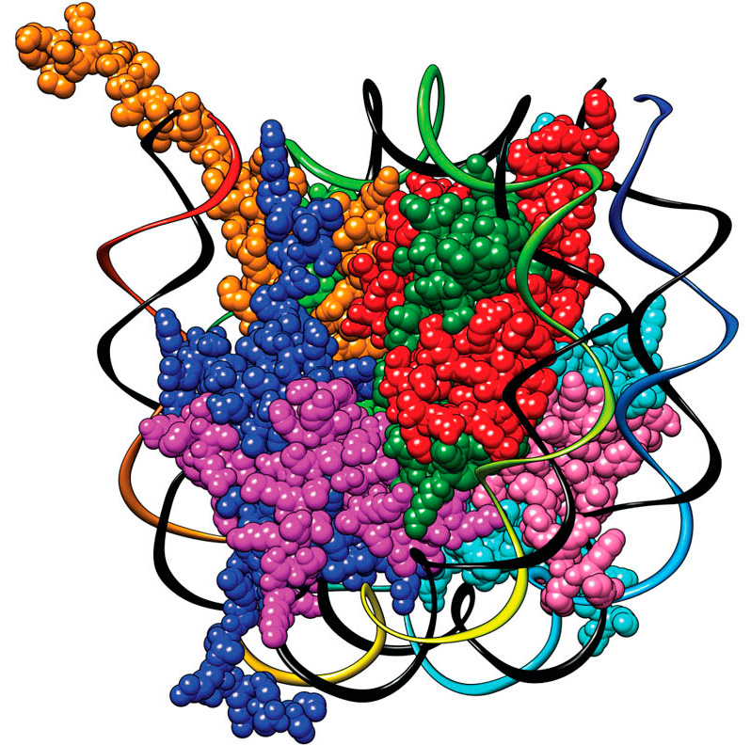
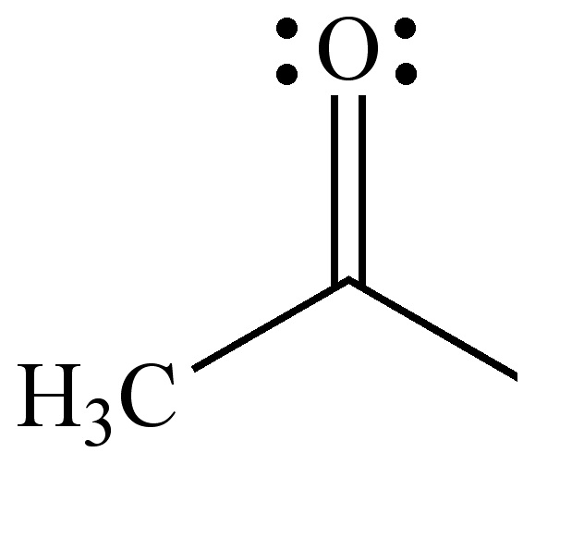

Slide 13
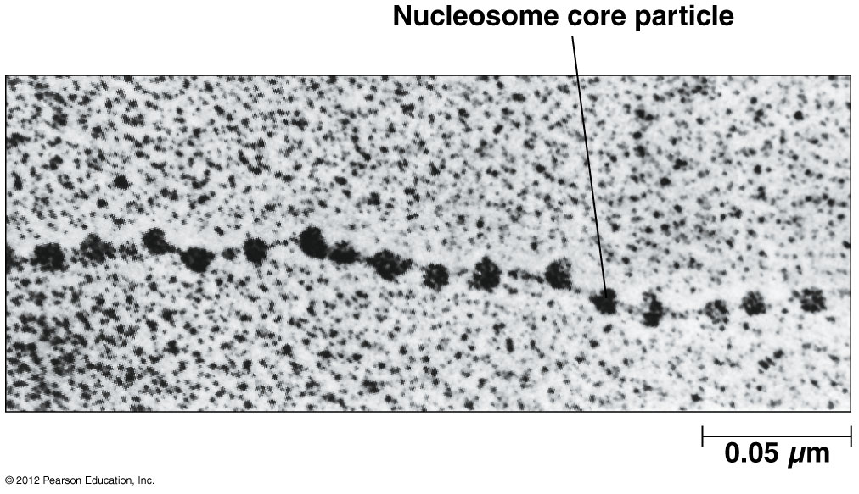

Slide 14
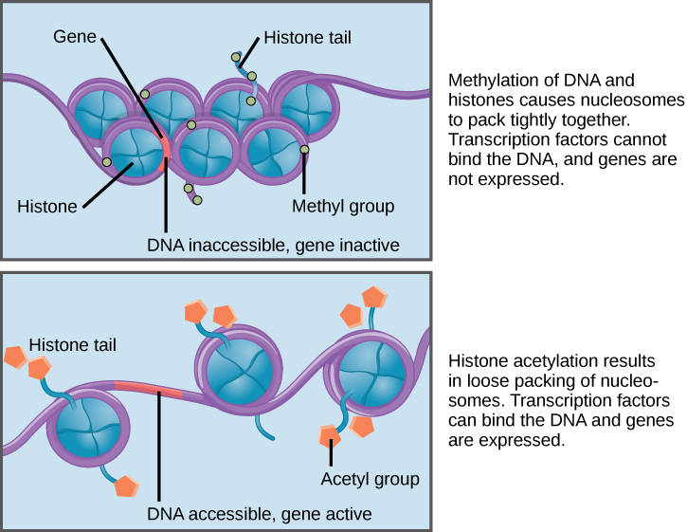

Slide 15
DNA Methylation

Slide 16
Transcription Factor
CH3
PROMOTER REGION
GENE

Slide 17
Oh Rats! Epigenetics
Of mice and methyl groups …

Slide 18
Life’s a rat race
You are a rat. How you react to stressful events in your life (scarce food, predators) depends on your personality, which is determined both by your life experiences and your genetics.
  Credit: http://learn.genetics.utah.edu/content/epigenetics/rats/

Slide 19
Don’t worry, be happy…
You will need two allele cards
You could have a functional glucocorticoid receptor protein. (Would this be a Dominant or Recessive trait?)
You could have a nonfunctional or absent glucocorticoid receptor protein. (Would this be a Dominant or Recessive trait?)
Notes:
Start the class with F(R)=0.5, F(r)=0.5, so that polling the class on their phenotype will yield 3:1 Mendelian ratio of relaxed/anxious

Slide 20
Don’t worry, be happy!
[Clicker Question] So, what’s your phenotype?
RR
Rr
rr Anxious
Relaxed
Notes:
3:1 Mendelian ratio, as expected.

Slide 21
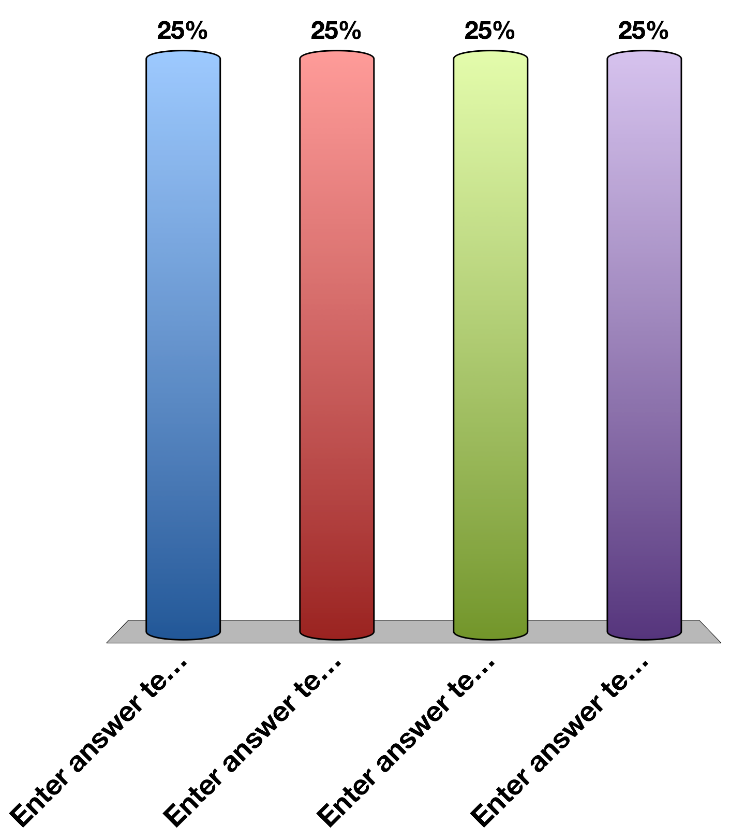
Clicker question: What’s your phenotype?
Relaxed (RR or Rr)
Anxious (rr)

Slide 22
Oh, rats!
If your allele has a mark, it is methylated.
→From what you just learned, is it a functional gene?
[Clicker question] What’s your actual phenotype, taking this epigenetic effect into account?
Notes:
Surprise—some of the glucocorticoid receptor genes are turned off, so there are more anxious rats than would be expected by the genotype frequencies.

Slide 23
Clicker question: Taking the epigenetic effect into account, what’s your actual phenotype?
Relaxed
Anxious

Slide 24
Breeding like rats
Reproduce with a partner by randomly drawing one of your two alleles (a gamete) and one of your partner’s alleles (another gamete).
When DNA is replicated, special enzymes read the methylation state of the DNA, and write those methyl groups onto the replicated strands. This process isn’t perfect, and sometimes methyl groups are not written (demethylation). Flip a coin to determine whether demethylation happened during meiosis in the production of your gamete.
Notes:
If demethylation didn’t occur, more and more of our DNA would become methylated over time.

Slide 25
Breeding like rats
[Clicker question] What’s your offspring’s phenotype at birth, taking this epigenetic effect into account?
Notes:
So now there are fewer anxious rats than would have been expected, since some alleles became demethylated.

Slide 26
Clicker question: What’s your offspring’s phenotype at birth, taking this epigenetic effect into account?
Relaxed
Anxious
Enter answer text...
Enter answer text...

Slide 27
Life’s a Rat race
Very stressful life events can cause your DNA to become methylated. Check your worksheet to determine if you experienced a stressful life event. If you escaped death once, you methylate one allele at random, if you escaped death twice, methylate both. If you did not encounter a predator methylate nothing.
[Clicker question] Now, what’s your offspring’s phenotype at adulthood, taking this epigenetic effect of acquired DNA methylation into account?
Notes:
Just like demethylation during DNA replication can erase epigenetic changes over time, new epigenetic changes can occur as a result of the environment. An example of this in humans is famine.

Slide 28
Clicker question: Now, what’s your offspring’s phenotype at adulthood, taking this epigenetic effect of acquired DNA methylation into account?
Relaxed
Anxious

Slide 29
Life’s a rat race
From your point of view as a lazy well-fed human, being anxious is probably a bad thing. But most other animals don’t have it so easy. If you were a rat…

Slide 30

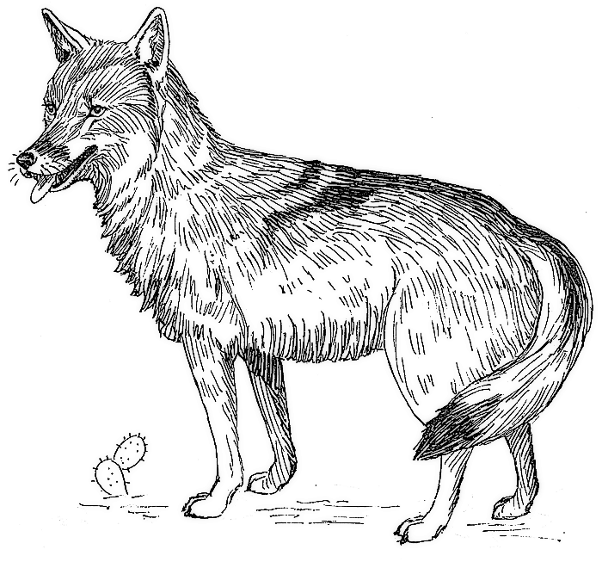
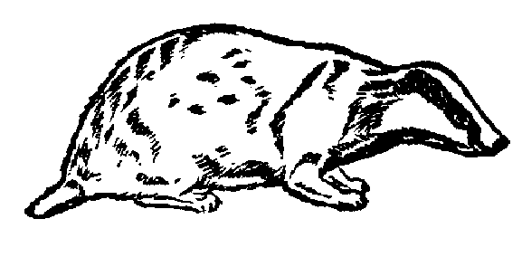
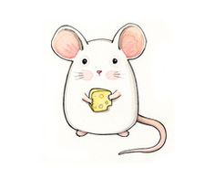

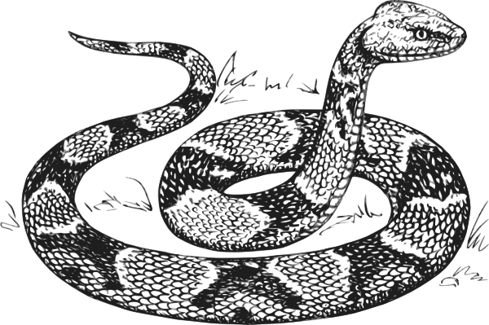

Slide 31
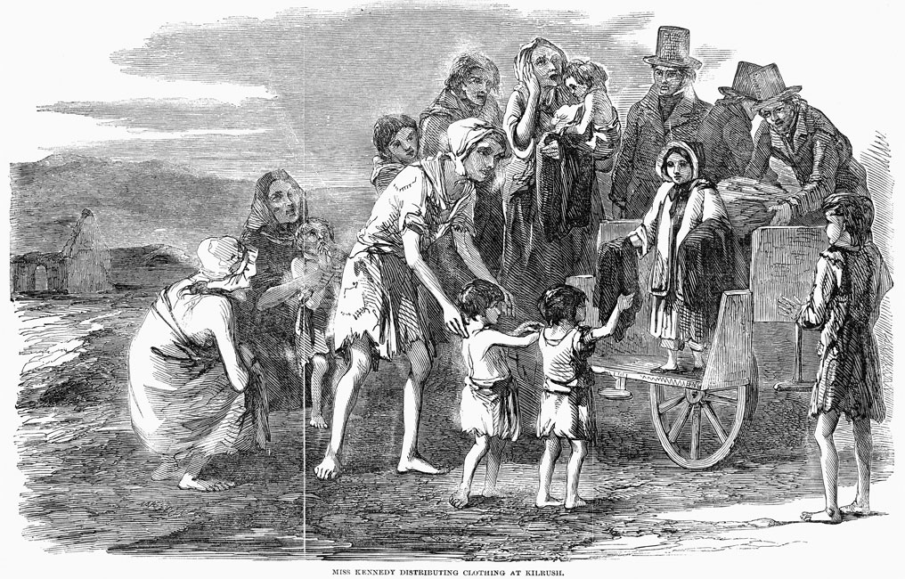

Slide 32
Epigenetic Inheritance
The Dutch Famine (Hongerwinter) of 1944-1945 is a well-studied case in which the heights of children born to women pregnant during the famine.

Slide 33
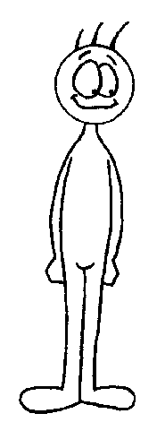

What do you predict were the relative heights for children born to mothers born during the famine?
What do you predict were the relative heights for children born during the famine?
PARENTS
FAMINE
NO PARENTS
FAMINE
FAMINE
NO FAMINE

Slide 34
Question:
What might be the evolutionary adaptive potential of giving birth to a smaller offspring during a famine?
The shorter you are the lower your daily caloric
requirements are!

Slide 35
Research determined these differences between individuals were epigenetic in nature!

Slide 36
Epigenetic Removal & Retention
Epigenetic markers are often lost during meiosis.
However, some special proteins are able to write and transfer methyl/acetyl groups during reprogramming.
Oddly, genes near the centromere of the chromosome are more readily re-methylated.

Slide 37
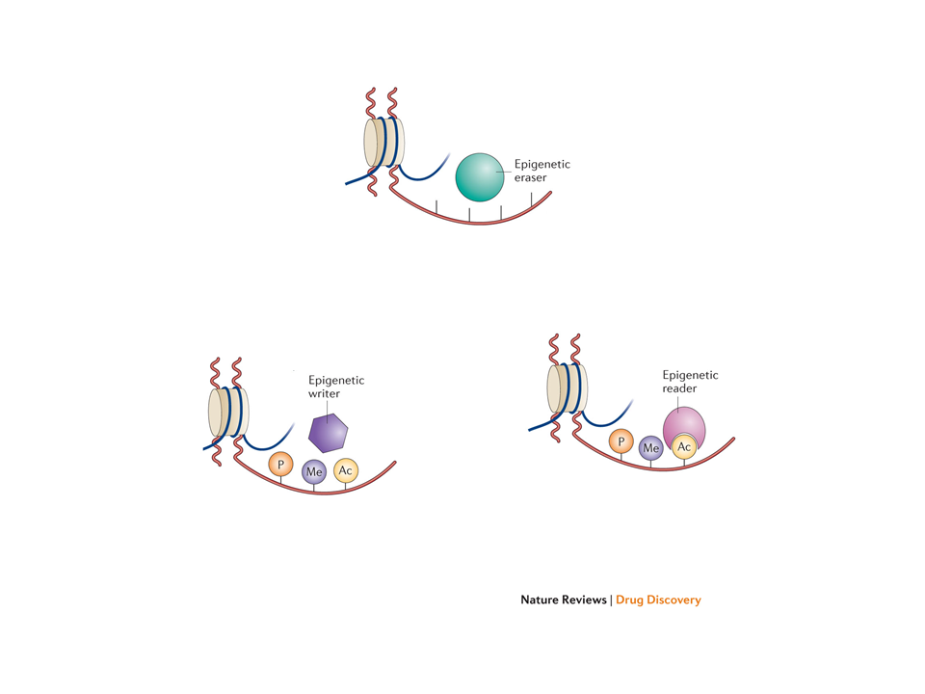

Slide 38
Post-Class Activities:
Watch the NOVA video on Epigenetics at http://www.pbs.org/wgbh/nova/body/epigenetics.html; there WILL be clicker questions on this!
Complete the “Your Environment, Your Epigenome!”
Review of abstracts from scientific literature.

