Slide 1
Teachable Tidbit: Photosynthesis for non-majors
Kristin Smock, Suma Robinson, Erica Szeyller, Adam Andrews , Michelle Withers,
Amy Stottlemyer

Slide 2
Learning Outcomes
Predict outcomes of perturbations to a model of photosynthesis.
  Explain the role of reactants and products
  Track origins of biomass and energy for a given item
  Explain/describe where O₂ comes from
  Describe roles of the light reactions and Calvin Cycle

Slide 3
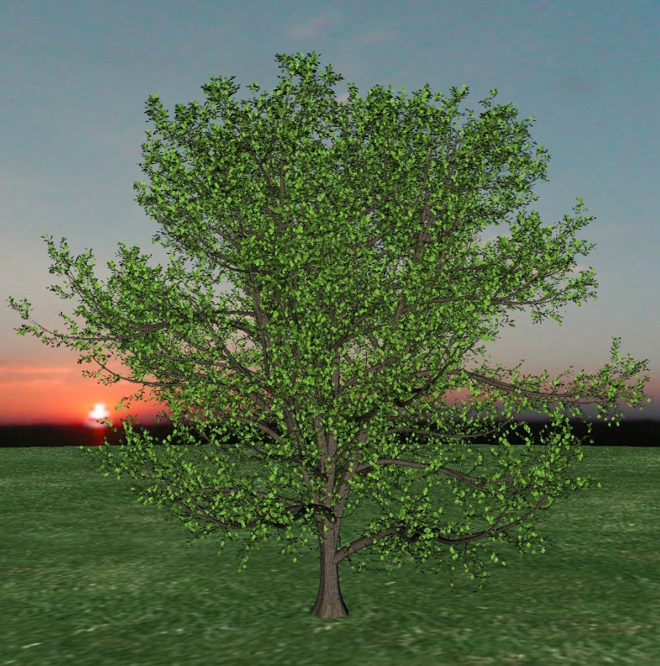
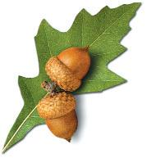
As the acorn grows into the tree, from where does the of the majority of the biomass come?
Air
Soil
Water
Sun
Notes:
Do this the way you would in class. Treat the audience as students and tell them that’s what you are doing.
Clicker this if you can.
When you get a variety of responses, have them discuss and re-poll.
Ask them then explain each response, i.e. is it right or wrong and why, or why would a student pick it if it is wrong.
Reflection:
When using this in class, if answers are diverse, then I have them discuss and repoll, but not if everyone gets it right – this is a student-centered response because what I do is based on student performance.
Also, students don’t just answer, but must go beyond and defend or explain answer instead of me doing that, i.e. students are answering and explaining, rather than me doing those higher order tasks.

Slide 4
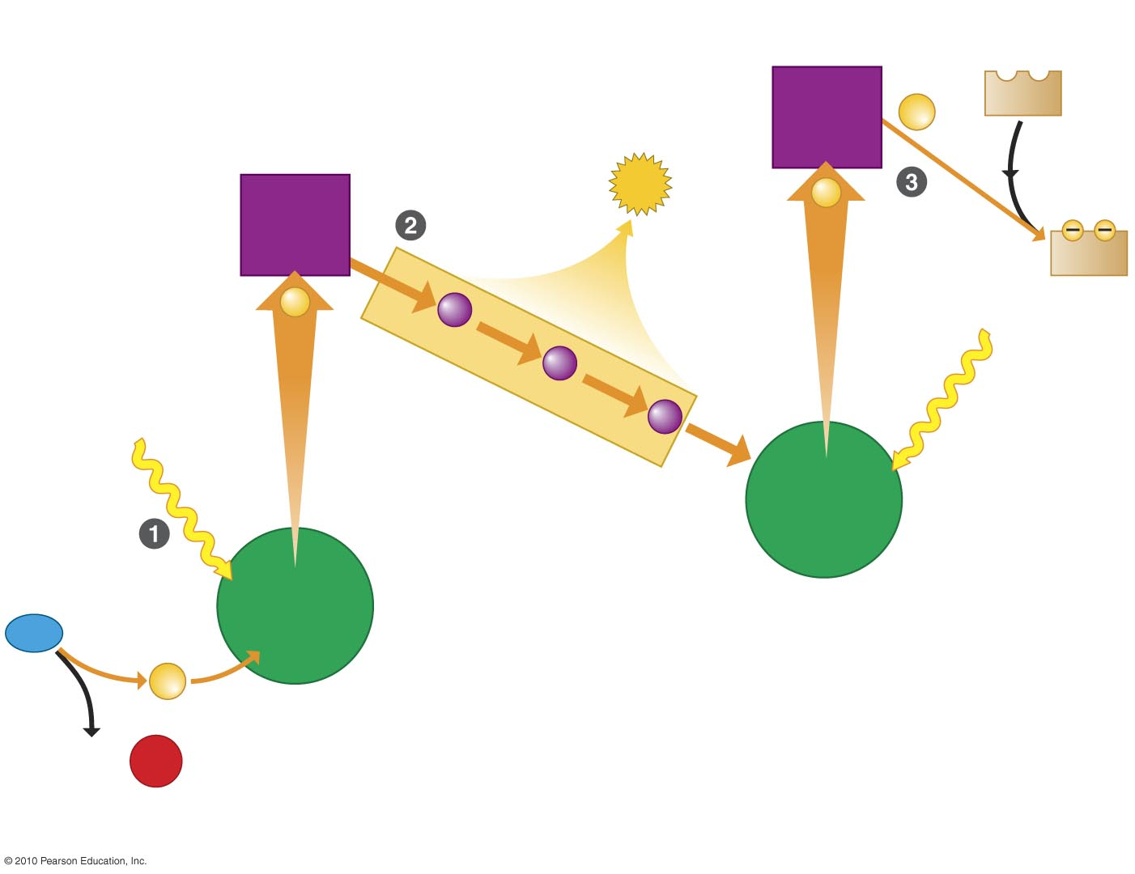

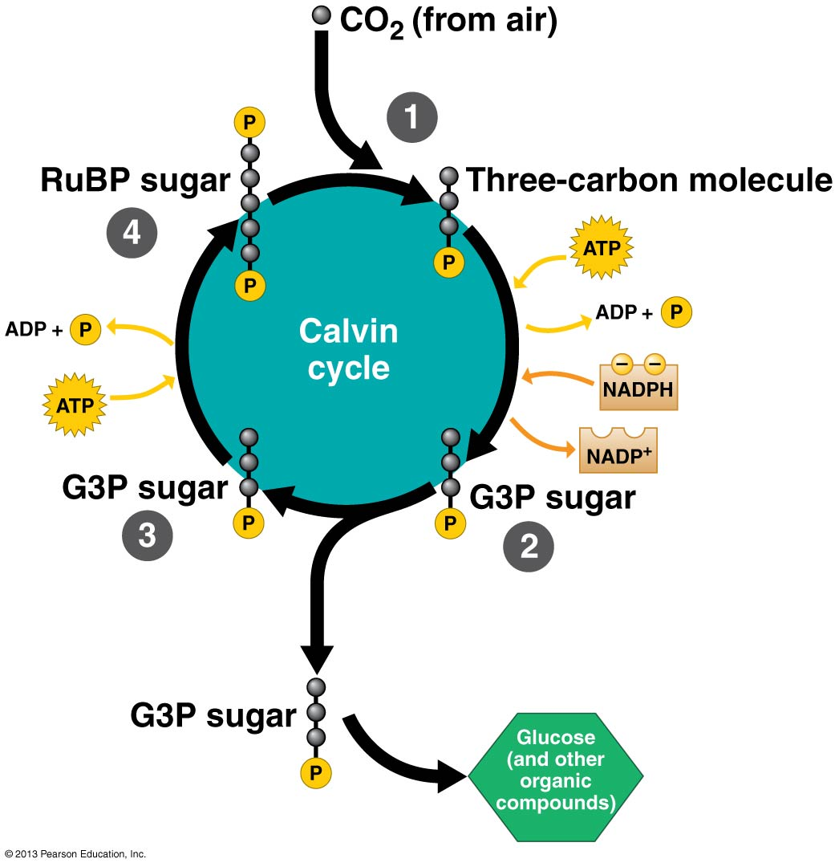

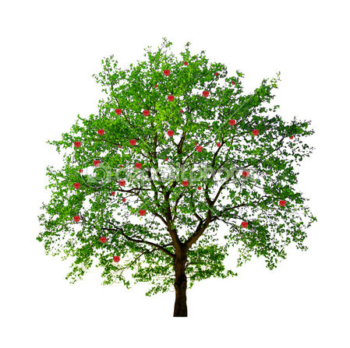
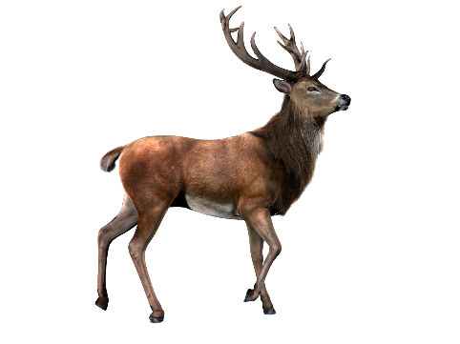

electron
acceptor
NADP⁺
2e
electron
acceptor
ATP
2e
NADPH
2e
Electron transport chain
2 H⁺
H₂O
2e
O₂

Slide 5
Use the model to determine which of the following statements is/are true.
As the concentrations of ATP and NADPH increase, the rate of glucose production increases.
The concentrations of ADP and NADP+ are regenerated during the Calvin cycle.
Electron excitation occurs in both the light dependent reaction and the Calvin cycle.
The oxygen you breathe comes from the CO₂ plants take in.

Slide 6
You own a cattle farm that feeds on a single grass species. You apply a new insecticide treatment to the grass that has the side effect of shutting down the Calvin cycle. Which of the following statements is/are true?
The grass will stop producing oxygen.
Your beef/dairy sales will decline.
The grass will survive because it still has ATP for energy.

Slide 7
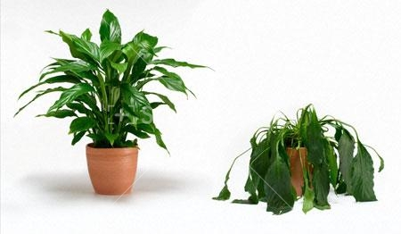
Use your model to make a hypothesis about this observation:
Pre-vacation
Post-vacation

Slide 8
Ecosystem Ecology /
Energy Flow
Cellular
Respiration
Photosynthesis

