Slide 1
Teachable tidbit for Bio1113:
Thermodynamics and Enzymes
Created By: Evan Waletzko, Nandini Shukla, Scott Prajzner
Facilitated By: David Sovic

Slide 2
Overall learning goals:
Is a given reaction spontaneous or not?
Is an enzyme used or not?
Learning Outcomes:
Students will be able to:
Predict spontaneity of reactions
Distinguish between enzyme-catalyzed and non-catalyzed reactions
  Interpret data from graphs
Develop hypotheses about potential uses of enzymes in commercial and personal applications

Slide 3
What are spontaneous and non-spontaneous reactions?
Spontaneous reactions: occur without any outside intervention when given enough time
Spontaneous!
Non-Spontaneous!

Slide 4
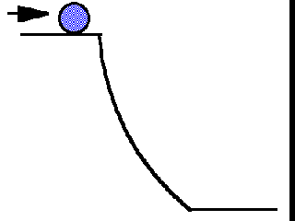
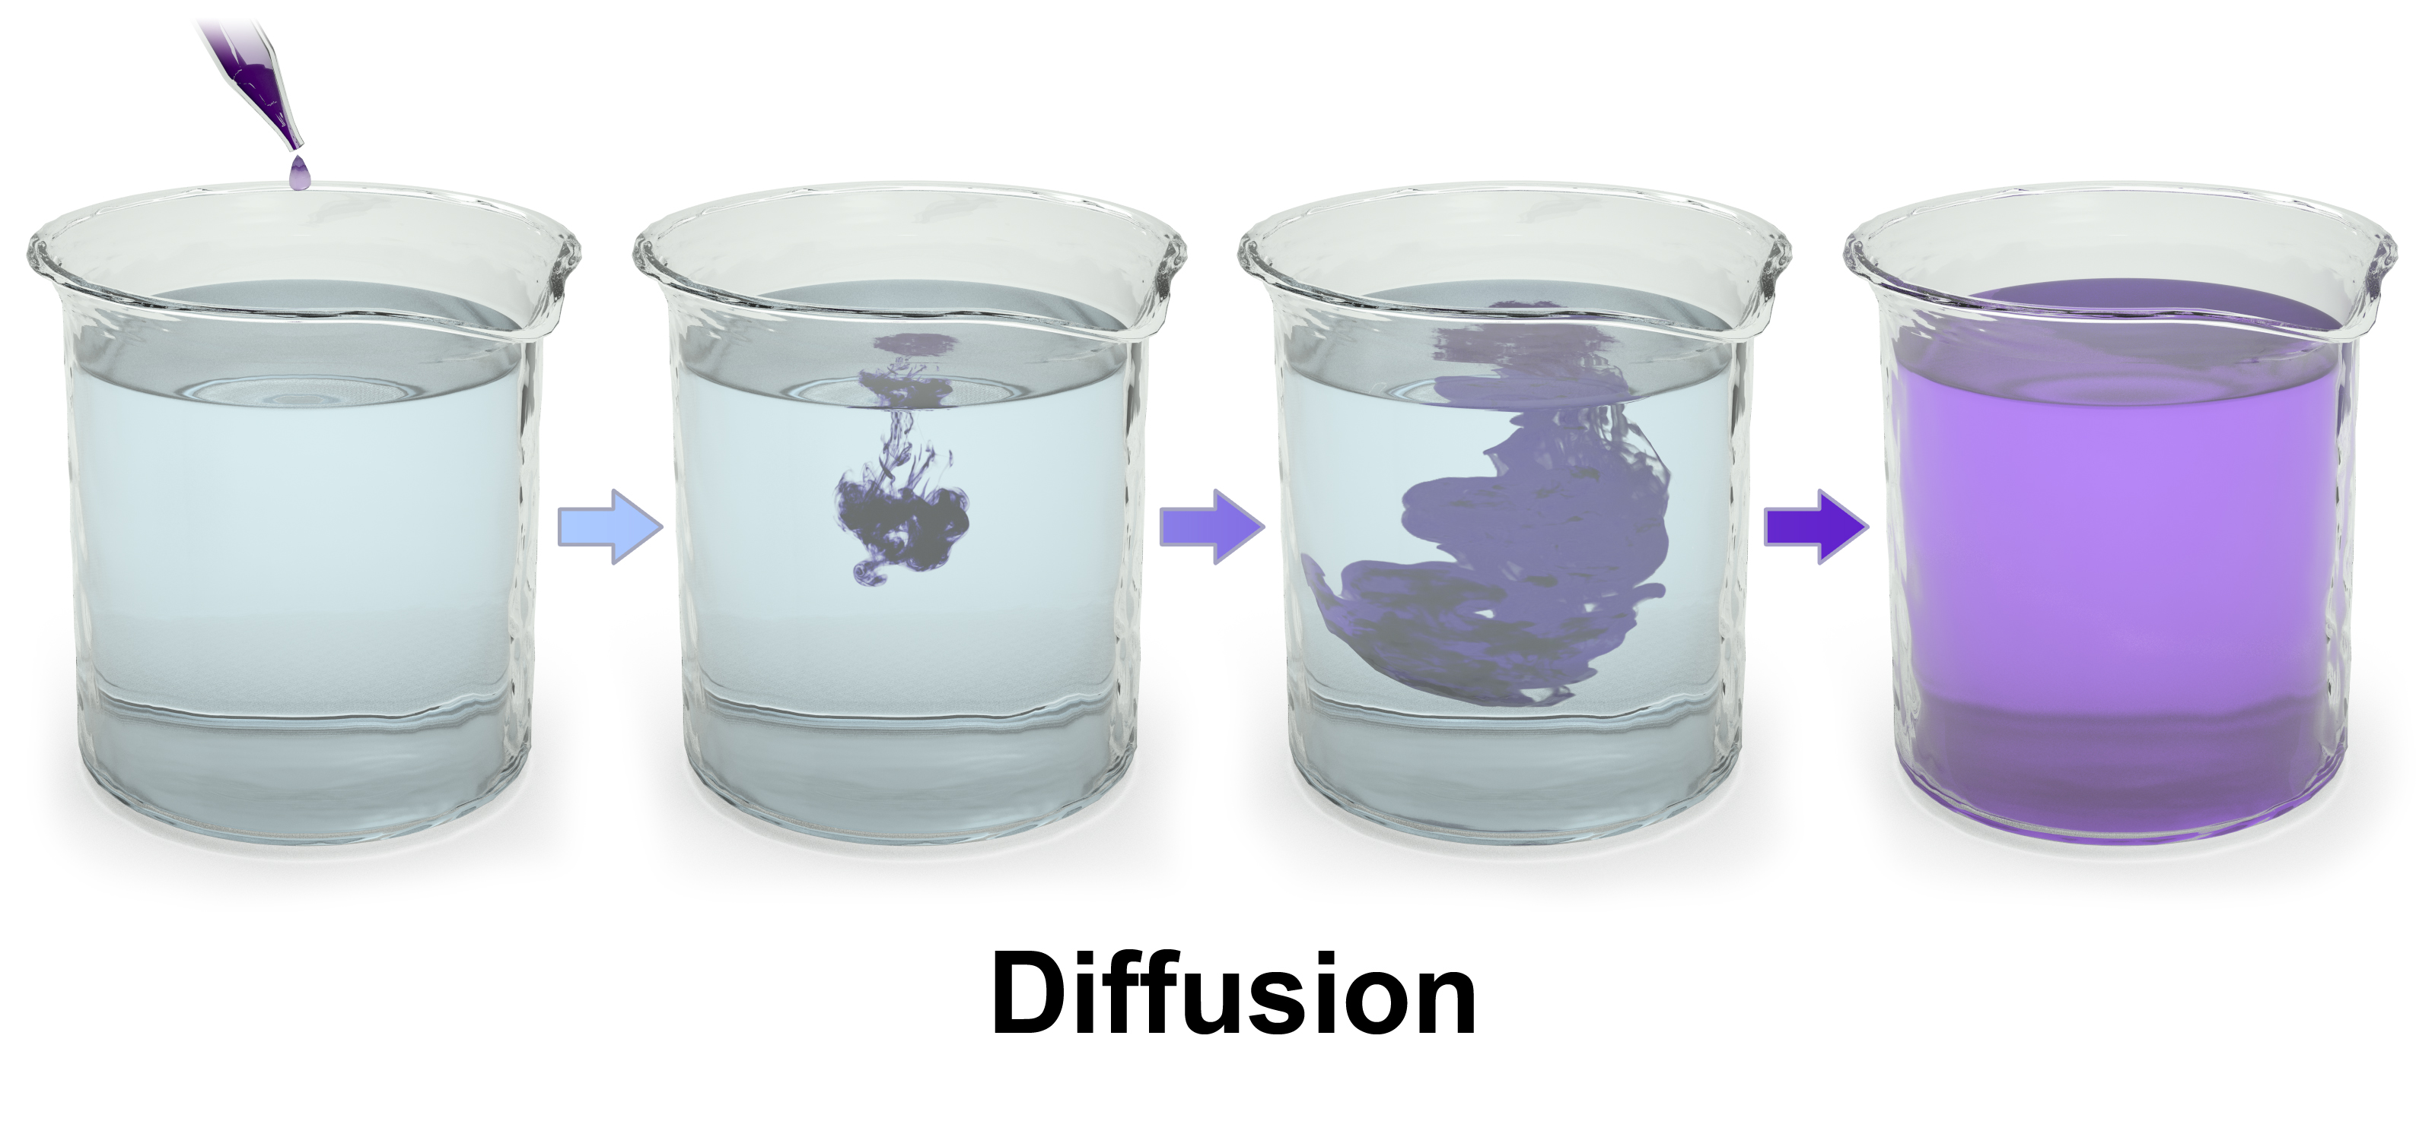
What are spontaneous and non-spontaneous reactions?
Spontaneous reactions: occur without any outside intervention when given enough time
Diffusion of ink in water
Rolling of a ball down an incline
(Blausen 0315 Diffusion.png; wikimedia commons)
(http://employees.csbsju.edu/hjakubowski/classes/ch331/lipidstruct/olthermoreview.htm )
Spontaneous reactions release energy and hence are also termed as exergonic reactions.

Slide 5
Cellular respiration and Photosynthesis are inverse processes
Cellular respiration
Glucose + oxygen
Carbon dioxide
+ water +
energy
Photosynthesis

Slide 6
Clicker question-1:
Is photosynthesis a spontaneous process?
Cellular respiration
Glucose + oxygen
Carbon dioxide
+ water +
energy
Photosynthesis
What is the energy source for photosynthesis?
Yes
No
✔

Slide 7
How can you predict whether a given reaction will occur spontaneously or not?
reactants
products
Apply the 2nd law of Thermodynamics!
Calculate the value of △G (the free energy change available to do work)
△G = G_{products} – G_{reactants}
If the value of △G is
negative => spontaneous reaction (energy released to do work)
positive => non-spontaneous reaction
zero => reaction is at equilibrium

Slide 8
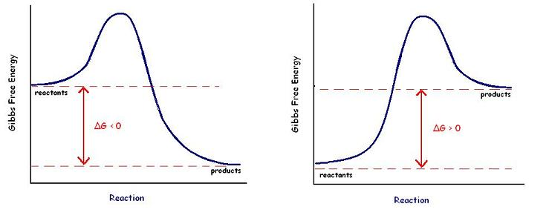
Clicker Question-2:
Look at the free energy change in the plots below and determine which of the following statements is true?
1
2
Free energy (G)
Free energy (G)
△G
△G
Progress of reaction
Progress of reaction
(https://en.wikibooks.org/wiki/Structural_Biochemistry/Enzyme/Gibbs_free_energy_graph)
Both the reactions are spontaneous
Both the reactions are non-spontaneous
1 = spontaneous ; 2 = non-spontaneous
1 = non-spontaneous ; 2 = spontaneous
✔

Slide 9
Notes for the instructor: How to set up the model for teaching how enzymes catalyze reactions. There is a model available and it is in the TA cabinet in Jennings Room70. The following slides will help you make your case without using a physical model (may be useful for big classrooms)
Some background relevant to this activity: A useful analogy to understand activation energy and enzymes is that of a ball rolling down an incline. The reaction that we are talking about is A → D. A is the reactant and D is the product. A, B and C represent the different possible energy states of the reactants and D is the energy state of the product. Note that the if the reactant is at energy state C, then the conversion of C→ D is a spontaneous process. Similarly, if the reactant is at energy state B, then the conversion of B→D is also spontaneous. If the reactant is at an energy level A, then the conversion from A→D represents equilibrium (since both D and A have the same free energy. For every reaction, I order to determine if it is spontaneous or not, we look at the free energy change and not just the individual Standard Free Energy of the components. This means that the spontaneity of the reaction depends not just on the free energies of the reactant and the product, but also on the temperature, because increasing the temperature will increase the free energy of the a substance. Hence always the Standard free energy of every chemical is determined at Standard temperature and Pressure.
Setting up the model: So you can begin by telling the students that a useful analogy to understand activation energy and enzymes is that of a ball rolling down an incline. The reaction proceeds from left to right. A, B and C represent the different energy states of the reactants and D is the energy state of the product. Now if you imagine that the ball represents an individual molecule, then you can see that the molecule can be at the level A, or B or C. At the energy level C, the molecule will have the maximum free energy followed by B, and then A. The molecule can be at either of the three levels A, B or C. (set up as an animation). Assume that the molecule is at the level C, then it can roll down the incline pretty smoothly and readily. Now ask the students, will the change from C to D be spontaneous? Yes! It is spontaneous since the net energy change is negative (product minus reactant). Now ask the students, if the ball is at the level B, then is the reaction from B→ D spontaneous? (again, the answer is yes, because deltaG is negative. Now ask the students, is there a direct way for the Ball to reach from B to D? (No! there is no direct route). Now ask them to discuss within their groups (or pairshare) as to what are a few ways in which you can tackle this issue? Are there alternative routes for the ball to go from B to D? (Yes, there are at least two ways, one is to take the ball from B to C and then the ball can roll down the incline readily. The second way is to decrease the size of the hill! So bring down the incline such that it goes from B to D now). So these two strategies represent different ways to carry out the reaction. One way is to supply a small amount of energy to the reaction and take the molecule from B to C and then the reaction will proceed on tis own. This means, that the molecule needs to overcome a small energy barrier i.e. C-B. This energy which we need to supply is the activation energy of the reaction. Hence, often we need to supply energy to the reactants so that they can overcome this small barrier called activation energy barrier. This route is analogous to raising the temperature of the system and it works in the following way: As you increase the temperature, you increase the kinetic energy of the and hence increase the collision frequency between the reactants. So now, there are more chances that the reactants will come into contact with each other so that they can interact and form the product. The second strategy is decreasing the height of the inclined which is analogous to using an enzyme and this is the mechanism that enzymes use to perform the reaction. Enzymes decrease the height of the activation energy barrier so that now the reaction is possible without the need to increase the temperature. This is what happens routinely in living systems because most organisms cannot afford to increase their temperature beyond a certain limit, else their proteins will denature. For most reactions, the situation is analogues to going rom B→ D and it is awesome to see the ways living systems tackle the issue of overcoming activation energy by evolving enzymes that can help carry out the reaction without increasing the temperature.

Slide 10
Rolling of a ball down an incline
C
G_{C} = 30
B
G_{B} = 20
A
D
G_{A} = 10
G_{D} = 10
A, B and C represent different energy levels

Slide 11
Rolling of a ball down an incline
C
G_{C} = 30
B
G_{B} = 20
A
D
G_{A} = 10
G_{D} = 10
A, B and C represent different energy levels

Slide 12
How does the ball reach the state ‘D’ ?
C
G_{C} = 30
?
B
G_{B} = 20
A
D
G_{A} = 10
G_{D} = 10
A, B and C represent different energy levels of reactants (different possible initial states of the system)
D is the product (final state)

Slide 13
How does the ball reach the state ‘D’ ?
C
B
Increase the temperature to overcome the Ea barrier
Keep the temperature the same, but lower the Ea barrier using an enzyme
A
D
C
C
B
B
A
D
A
D

Slide 14
Clicker Question-3:
Which of these represents a non-spontaneous reaction?
C
G_{C} = 30
B
G_{B} = 20
A
D
G_{A} = 10
G_{D} = 10
A → D
B → D
C → D
D → C
✔

Slide 15
Clicker Question-4:
Which of these represents a reaction at equilibrium?
C
G_{C} = 30
B
G_{B} = 20
A
D
G_{A} = 10
G_{D} = 10
✔
A → D
B → D
C → D
D → C

Slide 16
Clicker Question-5:
Which of these represents a scenario analogous to adding an enzyme to the reaction?
1
2
Both
None
C
✔
B
A
D
1
2
C
C
B
B
A
D
A
D

Slide 17
Clicker Question-6:
Which of these represents a scenario analogous to raising the temperature of the reaction?
✔
1
2
Both
None
C
B
A
D
1
2
C
C
B
B
A
D
A
D

Slide 18
Clicker Question-7:
Enzymes catalyze reactions by decreasing the activation energy (Ea) barrier of reactions. In this case, the Ea is represented by
C
C
B
B
A
D
A
D
G_{C}-G_{A}
G_{C}-G_{B}
G_{C}-G_{D}
G_{B}-G_{A}
✔

Slide 19
Activity: 2:
Interpret data from a trial to predict and draw the relative enzymatic reactions in graphical form
    The objective of this exercise is for you to interpret data from a series of treatments, and then create a graph for each treatment depicting the enzymatic process in terms of energy and the reaction progress.

Slide 20
Hypothesis
Adding an enzyme (saliva) to a food will increase the rate of a chemical reaction (browning of an apple).

Slide 21
Experimental design
Several apples, picked from a tree growing on East Ave. in Clintonville, were skinned and ground to a pulp using a blender.
Water was added to ensure blending was even. All treatments were made from this mixture.
Several treatments were made from this mixture
Observations were made every 5 minutes, and compared to the color chart on the next slide to quantify the change.
It is assumed a change of color indicates a chemical reaction.

Slide 22
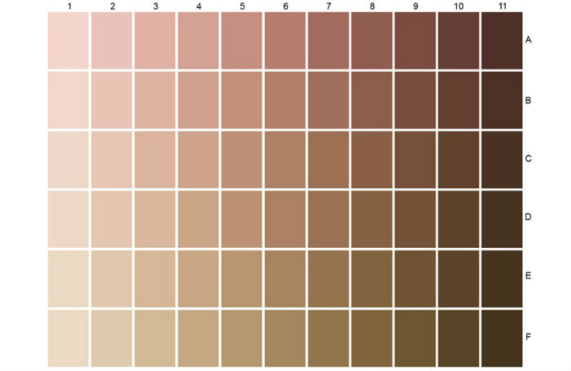
Color Chart
* Only used the chart for shading (columns/#’s) and not tone (rows/letters)

Slide 23
Treatments
  Cold
    A tablespoon of freshly ground apple is spread out in a small bowl exposing it to air. The bowl is placed in a refrigerator at approximately 4 C°
  Cold + Enzyme
    A tablespoon of freshly ground apple is spread out in a small bowl exposing it to air. Approximately ½ of a teaspoon of saliva was applied, and then mixed with a chop stick for 1 minute. The bowl is placed in a refrigerator at approximately 4 C°
  Ambient
    A tablespoon of freshly ground apple is spread out in a small bowl exposing it to air. It was left on a counter top at approximately 18 C°
  Ambient + Enzyme
    A tablespoon of freshly ground apple is spread out in a small bowl exposing it to air. Approximately ½ of a teaspoon of saliva was applied, and then mixed with a chop stick for 1 minute. It was left on a counter top at approximately 18 C°

Slide 24
Predictions
  Order the rate of reactions (browning) relative to one another for each of the four treatments
  Cold
  Cold + Enzyme
  Ambient
  Ambient + Enzyme
Results are graphed on the next slide

Slide 25
Browning of the four treatments over time

Slide 26
Use this template to draw the enzymatic reaction for each of the four treatments. Make sure each of the four graphs are relative to each other.

Slide 27
Use the graphs you just drew depicting each of the treatments to answer the following questions on the next four slides

Slide 28
Clicker Question-8:
Which line depicts the reaction of the ‘cold’ treatment
A.
B.
C.
D.

Slide 29
Clicker Question-9:
Which line depicts the reaction of the ‘cold + enzyme’ treatment
A.
B.
C.
D.

Slide 30
Clicker Question-10:
Which line depicts the reaction of the ‘ambient’ treatment
A.
B.
C.
D.

Slide 31
Clicker Question-11:
Which line depicts the reaction of the ‘ambient + enzyme’ treatment?
A.
B.
C.
D.

Slide 32
Consider the experimental design.
What flaw to the design would you correct?
Open ended class discussion

Slide 33
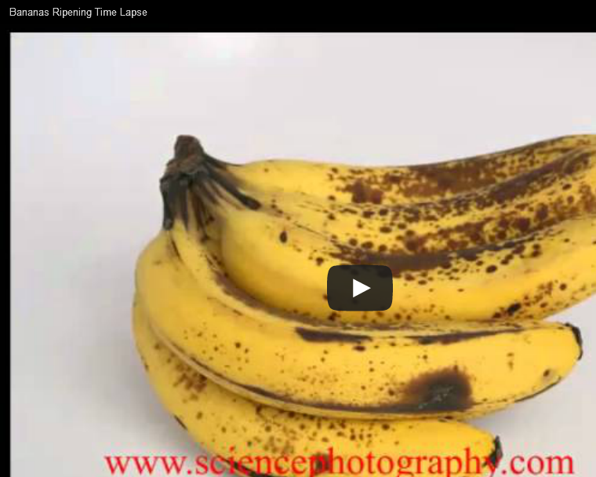
https://www.youtube.com/watch?v=tZSCsyRLWVA

Slide 34
You notice that when you place green bananas next to brown bananas on your kitchen counter that green bananas ripen much more quickly.
Why is this?

Slide 35
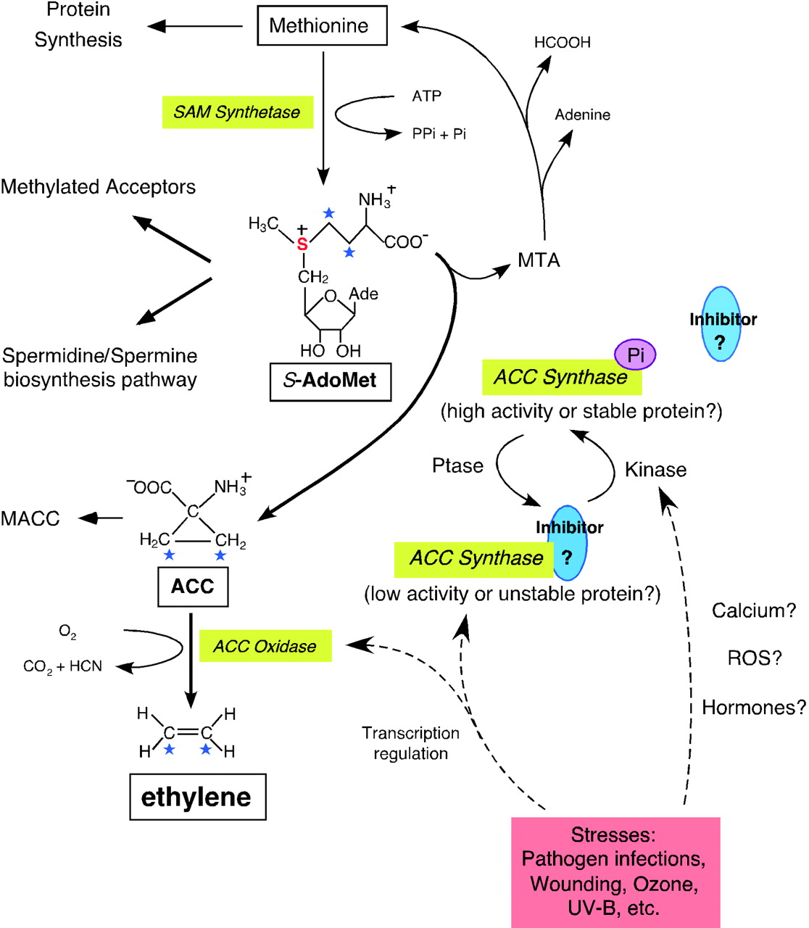

Biosynthetic Pathway and Regulation of Ethylene.
The formation of S-AdoMet is catalyzed by SAM synthetase from the methionine at the expense of one molecule of ATP per molecule of S-AdoMet synthesized.
Kevin L.-C. Wang et al. Plant Cell 2002;14:S131-S151
©2002 by American Society of Plant Biologists
Notes:
Biosynthetic Pathway and Regulation of Ethylene.The formation of S-AdoMet is catalyzed by SAM synthetase from the methionine at the expense of one molecule of ATP per molecule of S-AdoMet synthesized. S-AdoMet is the methyl group donor for many cellular molecules (Methylated Acceptors), including nucleic acids, proteins, and lipids. In addition, S-AdoMet is the precursor of the polyamine synthesis pathway (Spermidine/Spermine biosynthesis pathway). ACC is the immediate precursor of ethylene. The rate-limiting step of ethylene synthesis is the conversion of S-AdoMet to ACC by ACC synthase under most conditions. MTA is the by-product generated along with ACC production by ACC synthase. Recycling of MTA back to methionine conserves the methylthio group and is able to maintain a constant concentration of cellular methionine even when ethylene is rapidly synthesized. Malonylation of ACC to malonyl-ACC (MACC) deprives the ACC pool and reduces the ethylene production. ACC oxidase catalyses the final step of ethylene synthesis using ACC as substrate and generates carbon dioxide and cyanide. Transcriptional regulation of both ACC synthase and ACC oxidase is indicated by dashed arrows. Reversible phosphorylation of ACC synthase is hypothesized and may be induced by unknown phosphatases (Ptase) and kinases, the latter presumably activated by stresses. Both native and phosphorylated form (ACC synthase-Pi) of ACC synthase are functional, although the native ACC synthase may be less stable or active in vivo. A hypothetical inhibitor is associated with ACC synthase at the carboxyl end and may be dissociated from the enzyme if it is modified by phosphorylation at the vicinity.

Slide 36
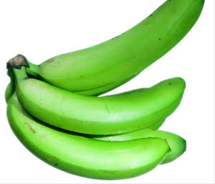
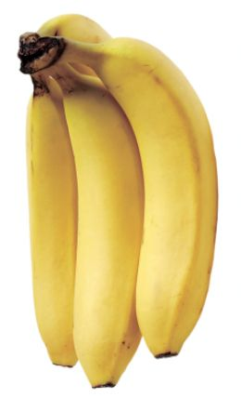
Ethylene stimulates enzyme production
produces
H₂C=CH₂
(ethylene)
induces/turns on
enzymes
genes
degrade
producing
parts of fruit
(chlorophyll, acids, starches, pectin, proteins, etc.)
resulting in
Adapted from http://www.slideserve.com/yahto/fruit-ripening-and-protease-activity © Janet Bryan

Slide 37
Group Discussion
1. Is banana ripening a spontaneous or non-spontaneous reaction?
2. What are the relative levels of ethylene in green, yellow, and brown bananas?
3. You notice that when you place green bananas next to brown bananas on your kitchen counter that green bananas ripen much more quickly. Why is this? How could you hasten the ripening?
4. What other phenomena in your everyday life do you think may be regulated by enzymes?

Slide 38
Clicker Question- 12:
Is banana ripening a spontaneous or non-spontaneous reaction? Predict the sign (+/ -) of △G accompanying this reaction.
Spontaneous; +
Spontaneous; -
Non-spontaneous; +
Non-spontaneous; -

Slide 39
Clicker Question-13:
What are the relative levels of ethylene in green, yellow, and brown bananas?
Green > yellow > brown
Yellow > green > brown
Brown > green > yellow
brown > yellow > green
Green = yellow = brown

