Slide 1
Context
Course: Biology 1113
Freshmen/Sophomores/Juniors
200+ students
Topic-biotechnology applications

Slide 2
Broad learning goal:
Students will be able to identify the most significant biomolecules exploited by technology including where they come from and explain the significance of their role in nature and role in humans.

Slide 3
Tidbit specific learning outcomes
Develop a logical process for a real life application of biotechnology using knowledge of biomolecules.
Relate evolution of biomolecules to potential bio technology application
Recognize that you can use bacterial enzymes in humans because of the universality of the genetic code

Slide 4
Students should already be able to
Identify the major biomolecules utilized in Biotechnology
Describe the function of the biomolecules in nature

Slide 5
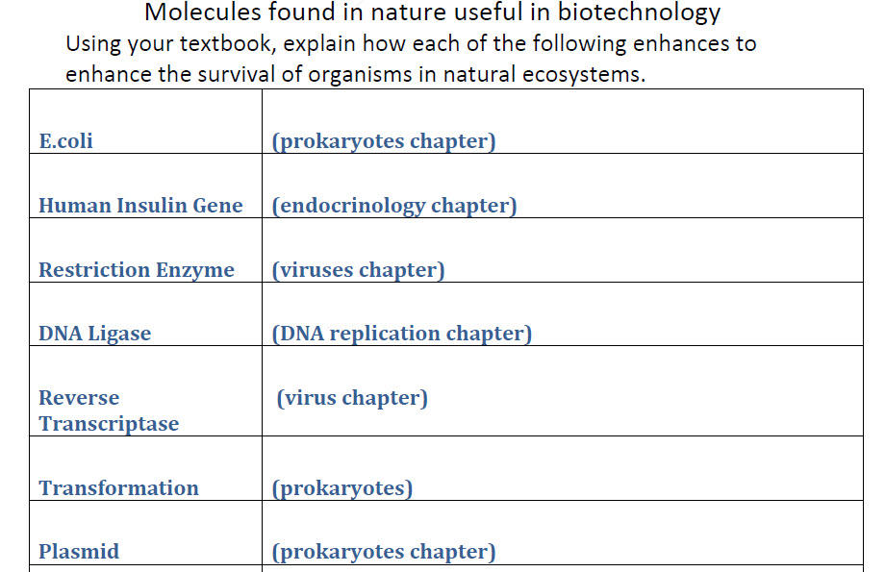
Last Time…

Slide 6
Today’s Topic
Biotech STUFFFFFF

Slide 7
Today’s Objective:
To develop a logical process for a real-life application of biotechnology using knowledge of biomolecules

Slide 8
Warm-Up Exercise
Brainstorm in your groups…what are some biotech applications that you are familiar with?

Slide 9
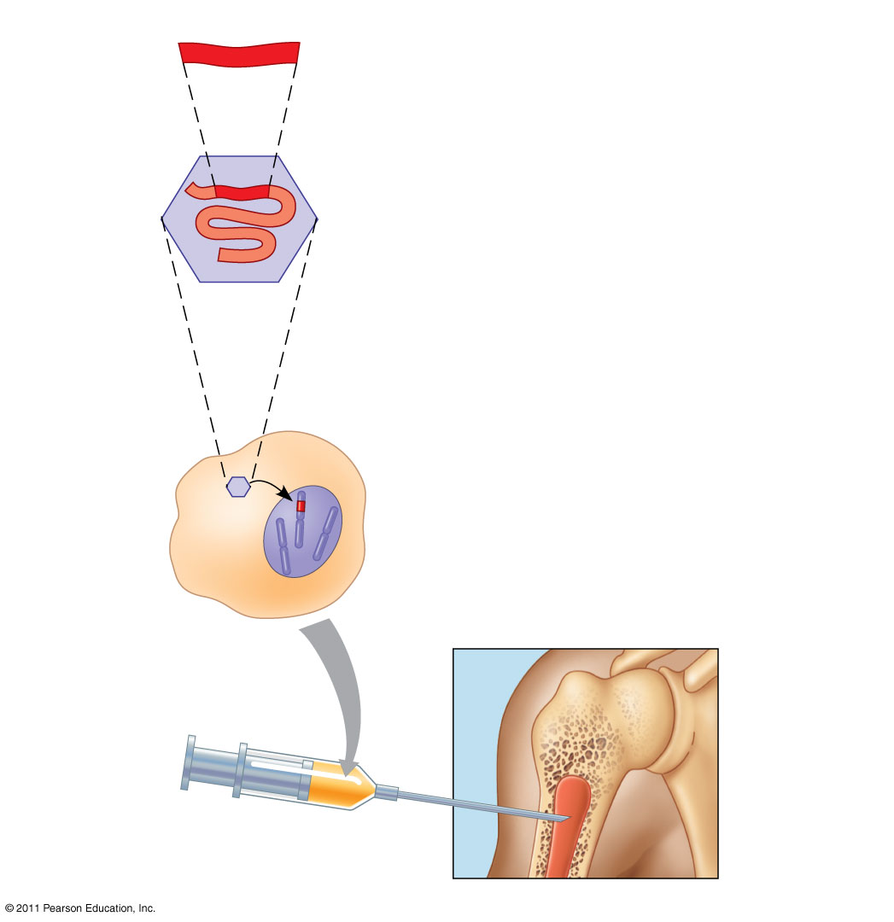
Figure 20.23
Cloned gene
Viral RNA
Bone
marrow
cell
Bone
marrow
Notes:
Figure 20.23 Gene therapy using a retroviral vector.

Slide 10
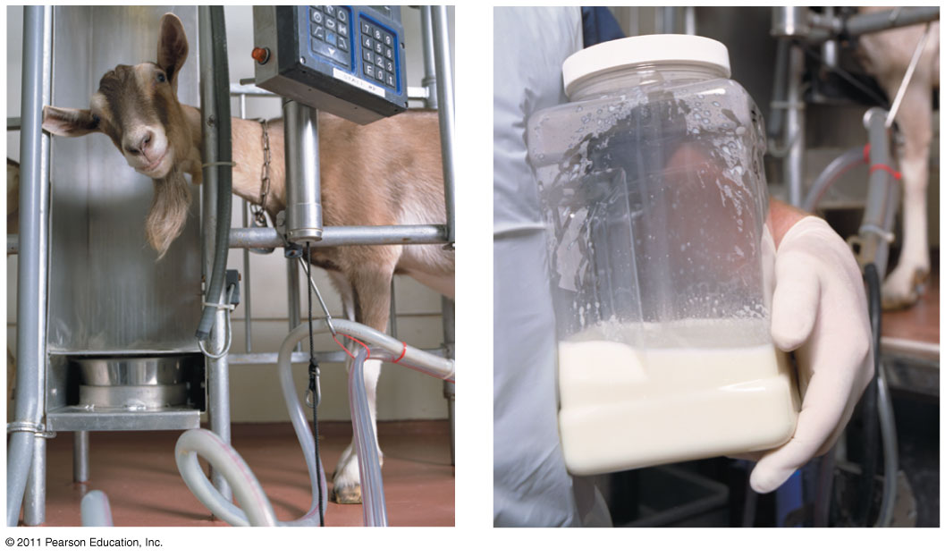
Figure 20.24
Notes:
Figure 20.24 Goats as “pharm” animals.

Slide 11
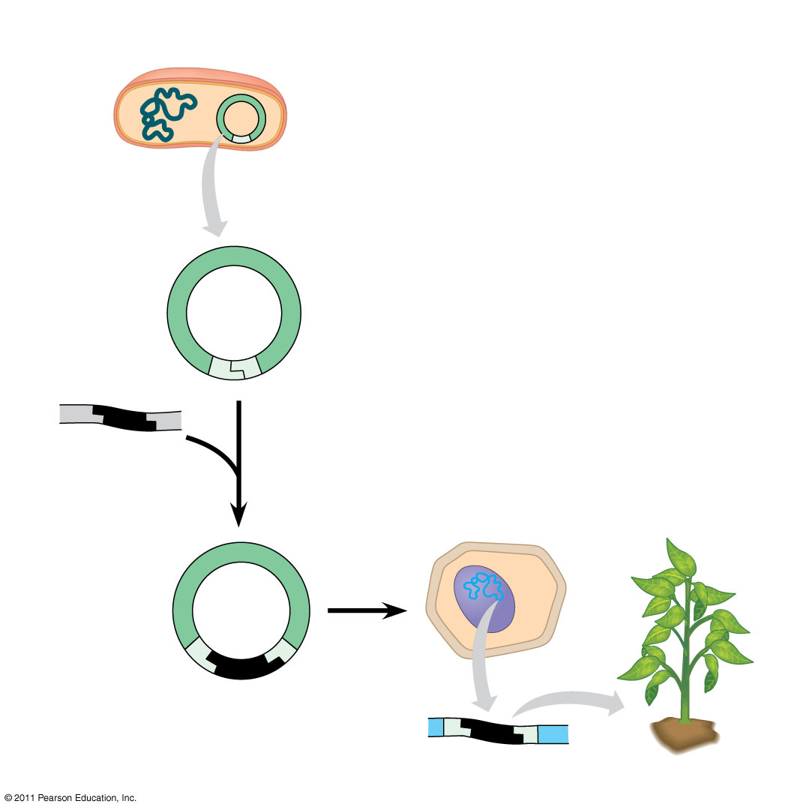
Figure 20.26
DNA with
the gene
of interest
RESULTS
Recombinant
Ti plasmid
Plant with new trait
Notes:
Figure 20.26 Research Method: Using the Ti Plasmid to Produce Transgenic Plants

Slide 12
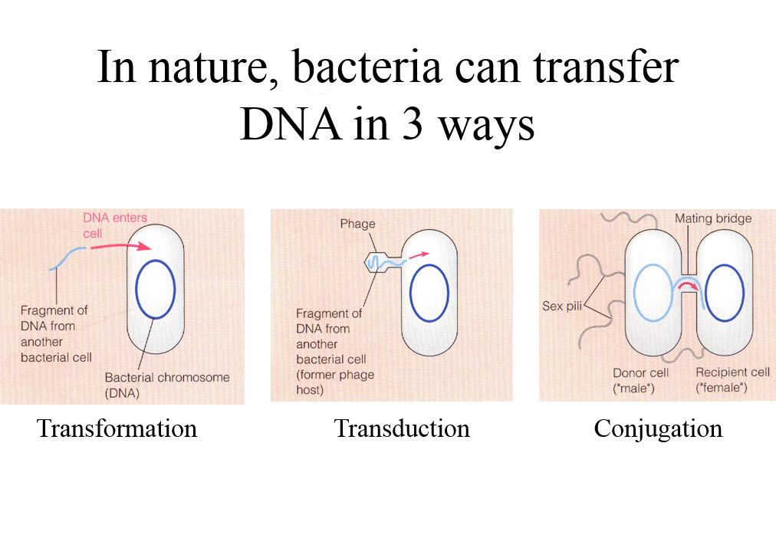

Slide 13
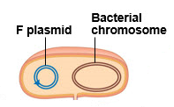

Slide 14
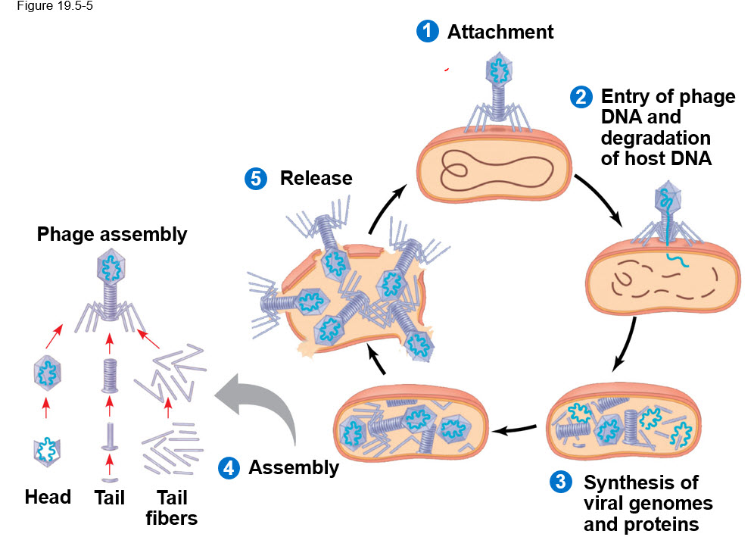

Slide 15
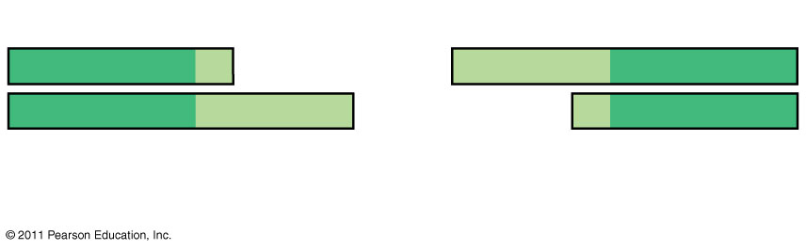
Figure 20.UN03
RESTRICTION ENZYME
5′
3′
5′
3′
G
AATTC
CTTAA
G
3′
5′
3′
5′
Sticky end
Notes:
Figure 20.UN03 Summary figure, Concept 20.1

Slide 16
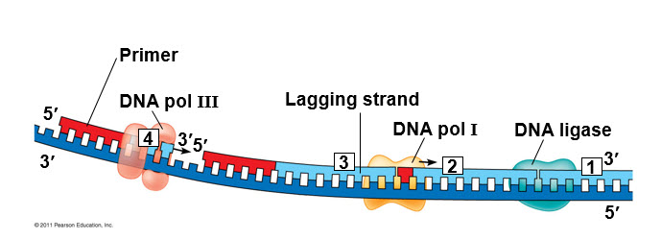

Slide 17
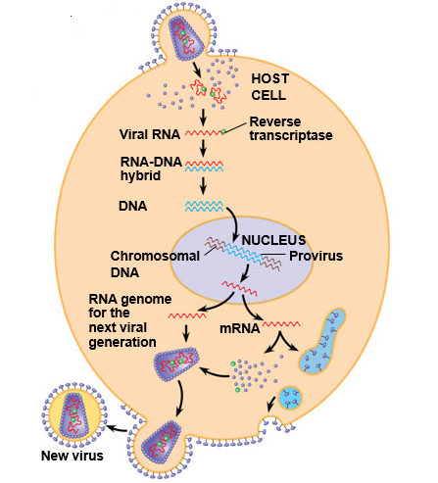

Slide 18
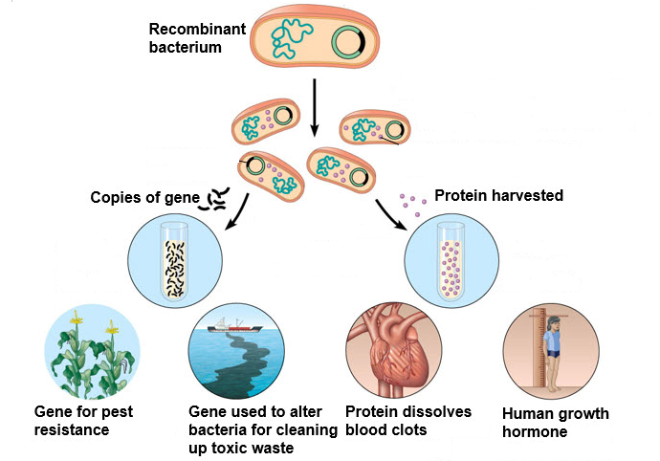

Slide 19
Last Time…
Table of Biomolecules

Slide 20
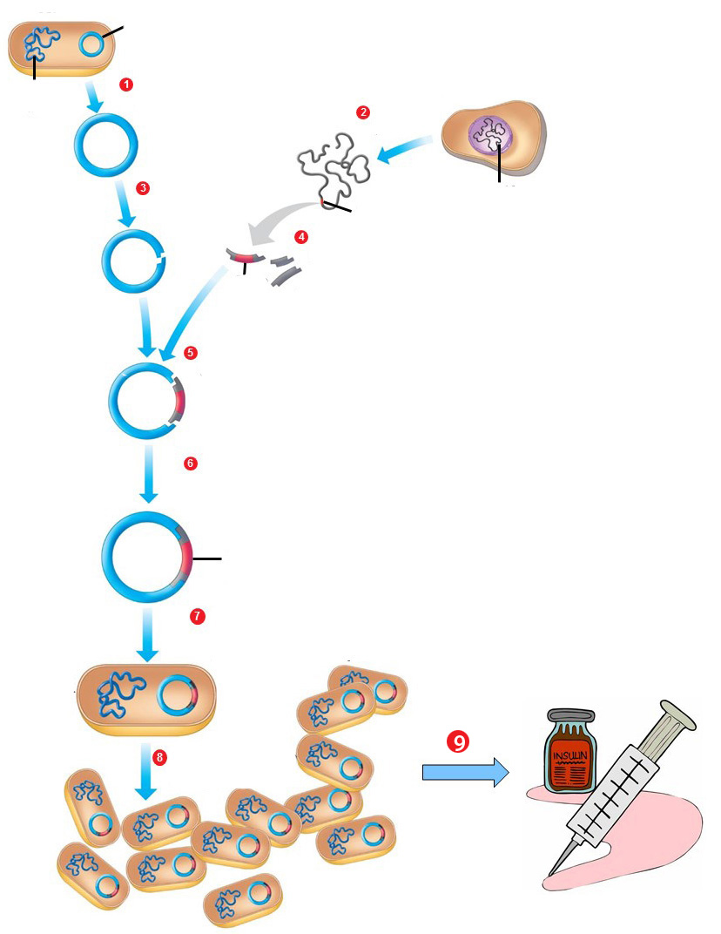
Biotech Applications
Problem:
- Diabetes affects millions of people in the US and around the world.
- More than 30% of affected individuals in the US require insulin to treat this condition.

Slide 21
Biotech Applications
Question:
How is human insulin mass produced for these patients using biotechnology?

Slide 22
We commonly utilize E. coli in biotechnology to produce proteins, but E. coli does not naturally carry the genetic information for the production of the insulin protein.
Think/Pair/Share Question:
  Based on the above, what has to happen in order to utilize E. coli to produce insulin?
Notes:
22
Answer expected: Must get the gene for insulin into the E. coli

Slide 23
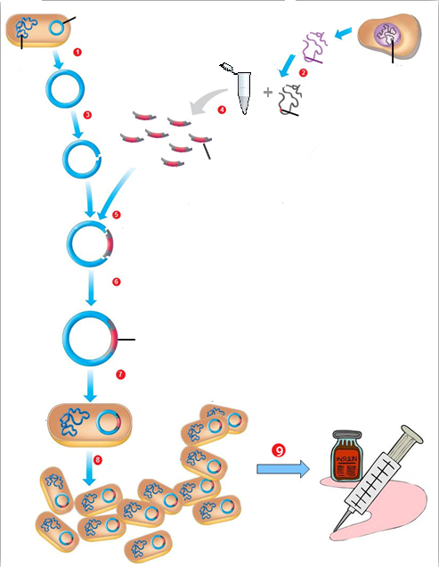
Please Refer to the Handout Provided
Let’s start at the end…
Notes:
23

Slide 24
What is happening in step 9?
Notes:
24

Slide 25
What is happening in step 9?
Insulin expression
and purification
Notes:
25

Slide 26
What change is occurring between the recombinant E. coli and the colony of E. coli after arrow 8?
Insulin expression
and purification
Notes:
26

Slide 27
What change is occurring between the recombinant E. coli and the colony of E. coli after arrow 8?
Insulin expression
and purification
Asexual Reproduction
Notes:
27

Slide 28
What process is occurring in step 7, and what do you think is being highlighted (red) in this plasmid?
Insulin expression
and purification
Asexual Reproduction
Notes:
28

Slide 29
What process is occurring in step 7, and what do you think is being highlighted (red) in this plasmid?
Transformation
Insulin expression
and purification
Asexual Reproduction
Notes:
29

Slide 30
What process is occurring in step 7, and what do you think is being highlighted (red) in this plasmid?
Human Insulin Gene
(recombinant DNA sequence)
Transformation
Insulin expression
and purification
Asexual Reproduction
Notes:
30

Slide 31
How might have the human insulin gene from step 7 been incorporated into a cut plasmid?
Human Insulin Gene
(recombinant DNA sequence)
Transformation
Insulin expression
and purification
Asexual Reproduction
Notes:
31

Slide 32
How might have the human insulin gene from step 7 been incorporated into a cut plasmid?
Ligation
(DNA fragment bonding)
Human Insulin Gene
(recombinant DNA sequence)
Transformation
Insulin expression
and purification
Asexual Reproduction
Notes:
32

Slide 33
How might have the human insulin gene from step 7 been incorporated into a cut plasmid?
Ligation
(DNA fragment bonding)
DNA Ligase
Human Insulin Gene
(recombinant DNA sequence)
Transformation
Insulin expression
and purification
Asexual Reproduction
Notes:
33

Slide 34
Discuss in Group steps 5, 4, 3, 2, 1…
Ligation
(DNA fragment bonding)
Effect of DNA ligase
(integration into plasmid)
Human Insulin Gene
(recombinant DNA sequence)
Transformation
Insulin expression
and purification
Asexual Reproduction
Notes:
34
6.63
5.12
4.42 0.83

Slide 35
E. coli genomic DNA
Ligation
(DNA fragment bonding)
Effect of DNA ligase
(integration into plasmid)
Human Insulin Gene
(recombinant DNA sequence)
Transformation
Insulin expression
and purification
Asexual Reproduction
Notes:
35
6.63
5.12
4.42 0.83

Slide 36
Plasmid
extraction
E. coli genomic DNA
Ligation
(DNA fragment bonding)
Effect of DNA ligase
(integration into plasmid)
Human Insulin Gene
(recombinant DNA sequence)
Transformation
Insulin expression
and purification
Asexual Reproduction
Notes:
36
6.63
5.12
4.42 0.83

Slide 37
Plasmid
extraction
E. coli genomic DNA
Restriction Enzyme Digestion
Ligation
(DNA fragment bonding)
Effect of DNA ligase
(integration into plasmid)
Human Insulin Gene
(recombinant DNA sequence)
Transformation
Insulin expression
and purification
Asexual Reproduction
Notes:
37
6.63
5.12
4.42 0.83

Slide 38
Plasmid
extraction
E. coli genomic DNA
mRNA
Restriction Enzyme Digestion
Ligation
(DNA fragment bonding)
Effect of DNA ligase
(integration into plasmid)
Human Insulin Gene
(recombinant DNA sequence)
Transformation
Insulin expression
and purification
Asexual Reproduction
Notes:
38
6.63
5.12
4.42 0.83

Slide 39
Plasmid
extraction
E. coli genomic DNA
mRNA
RT
Restriction Enzyme Digestion
Ligation
(DNA fragment bonding)
Effect of DNA ligase
(integration into plasmid)
Human Insulin Gene
(recombinant DNA sequence)
Transformation
Insulin expression
and purification
Asexual Reproduction
Notes:
39
6.63
5.12
4.42 0.83

Slide 40
Plasmid
extraction
E. coli genomic DNA
mRNA
RT
Restriction Enzyme Digestion
cDNA
Ligation
(DNA fragment bonding)
Effect of DNA ligase
(integration into plasmid)
Human Insulin Gene
(recombinant DNA sequence)
Transformation
Insulin expression
and purification
Asexual Reproduction
Notes:
40
6.63
5.12
4.42 0.83

Slide 41
Plasmid
extraction
E. coli genomic DNA
mRNA
RT
Restriction Enzyme Digestion
cDNA
PCR
Ligation
(DNA fragment bonding)
Effect of DNA ligase
(integration into plasmid)
Human Insulin Gene
(recombinant DNA sequence)
Transformation
Insulin expression
and purification
Asexual Reproduction
Notes:
41
6.63
5.12
4.42 0.83

Slide 42
Plasmid
extraction
E. coli genomic DNA
mRNA
RT
Restriction Enzyme Digestion
cDNA
PCR
Amplified Insulin Gene
Ligation
(DNA fragment bonding)
Effect of DNA ligase
(integration into plasmid)
Human Insulin Gene
(recombinant DNA sequence)
Transformation
Insulin expression
and purification
Asexual Reproduction
Notes:
42
6.63
5.12
4.42 0.83

Slide 43
Thinking Further:
  Why do we use bacterial restriction enzymes to cut human DNA in biotech?
  From an evolutionary perspective, how can this prokaryotic enzyme be functional in both types of cells?
Notes:
43

